Slide 1
C196 Scheduler Mobile App Flow Of The Application On Next Slide

Slide 2
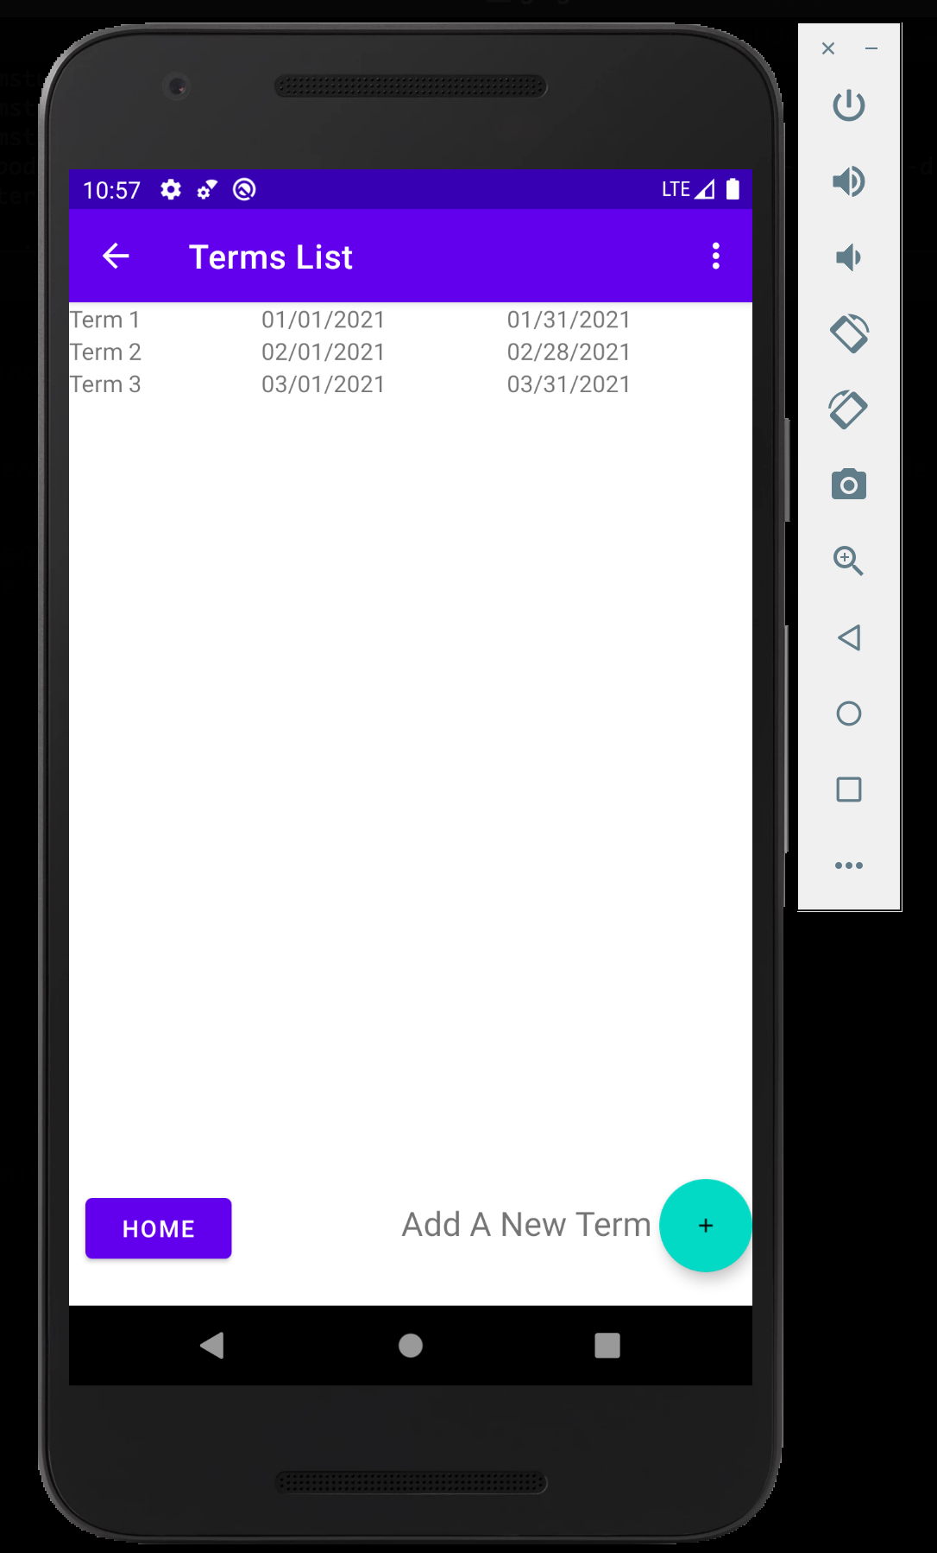
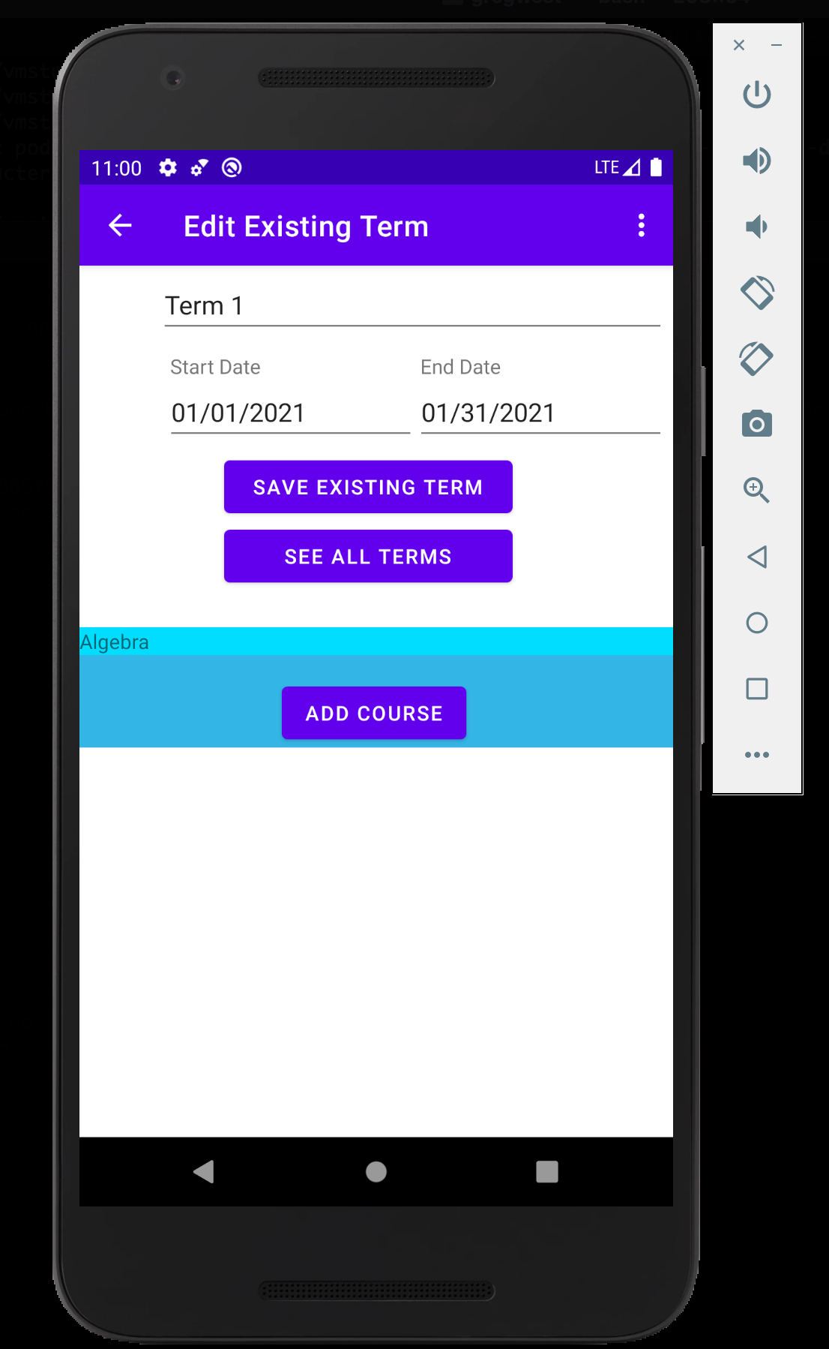
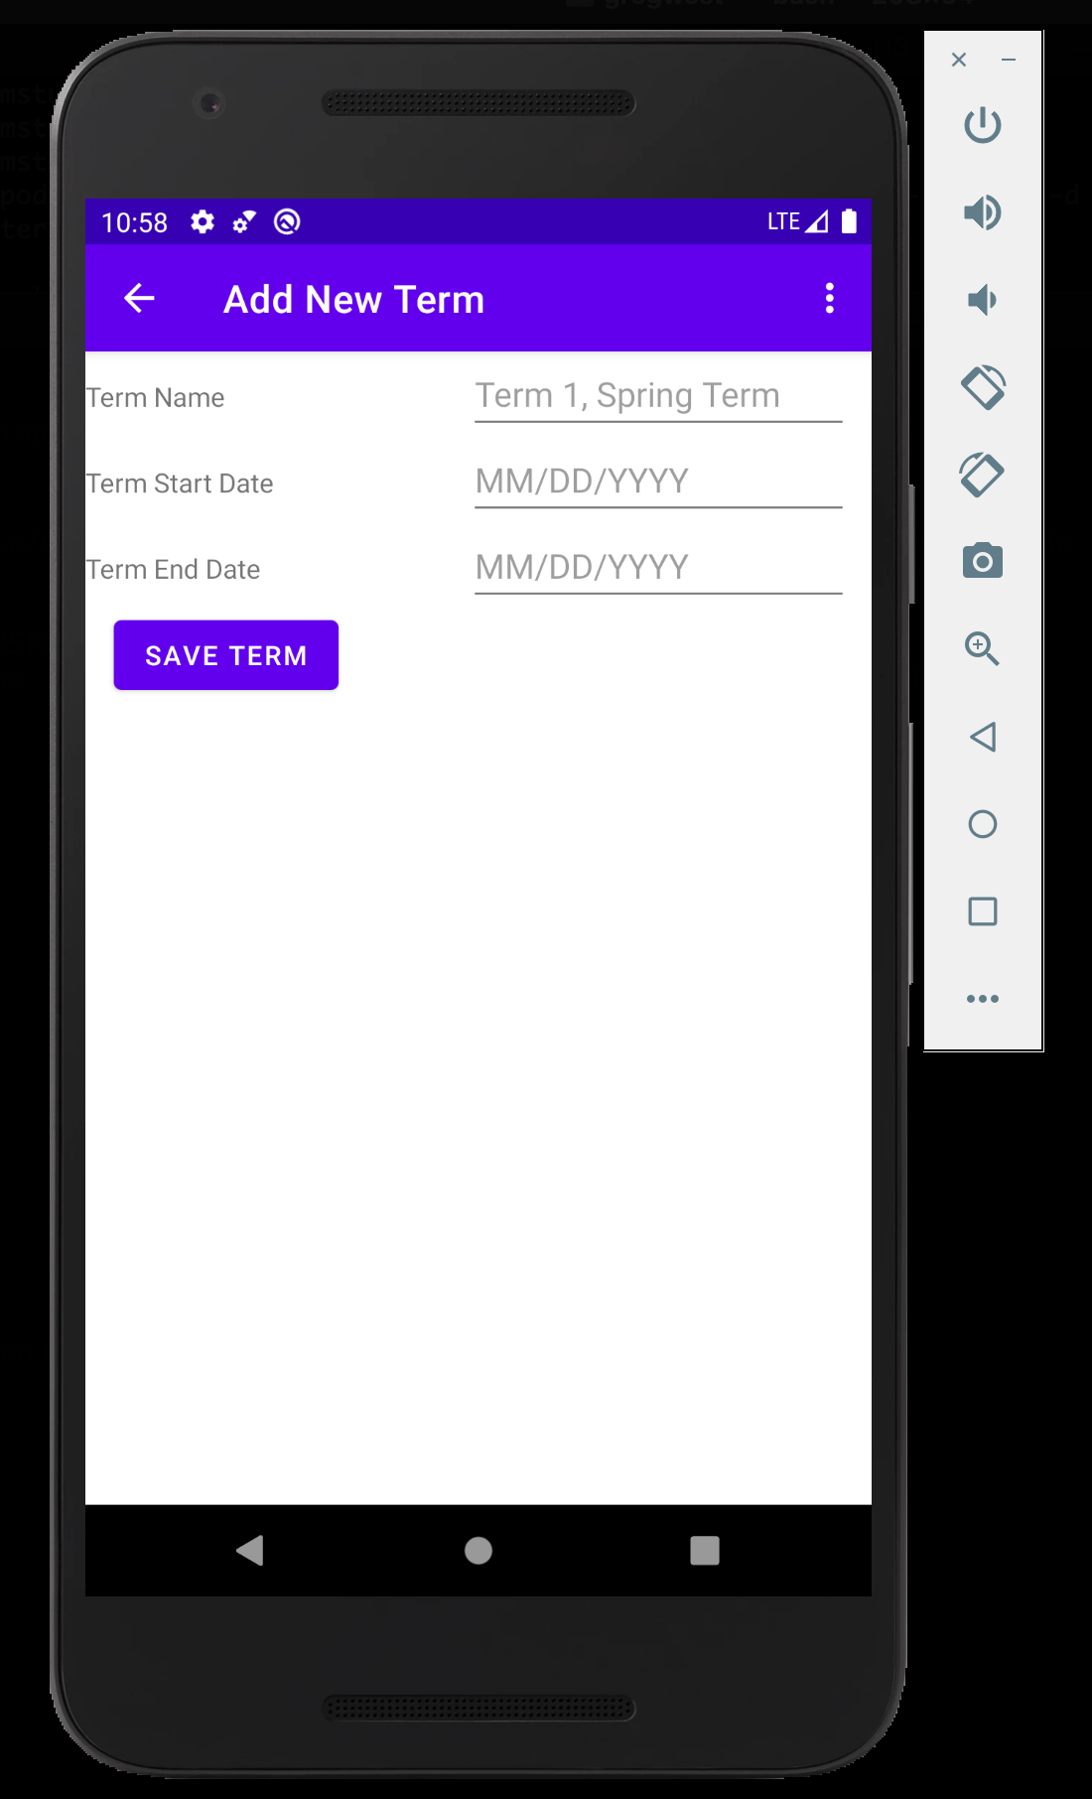
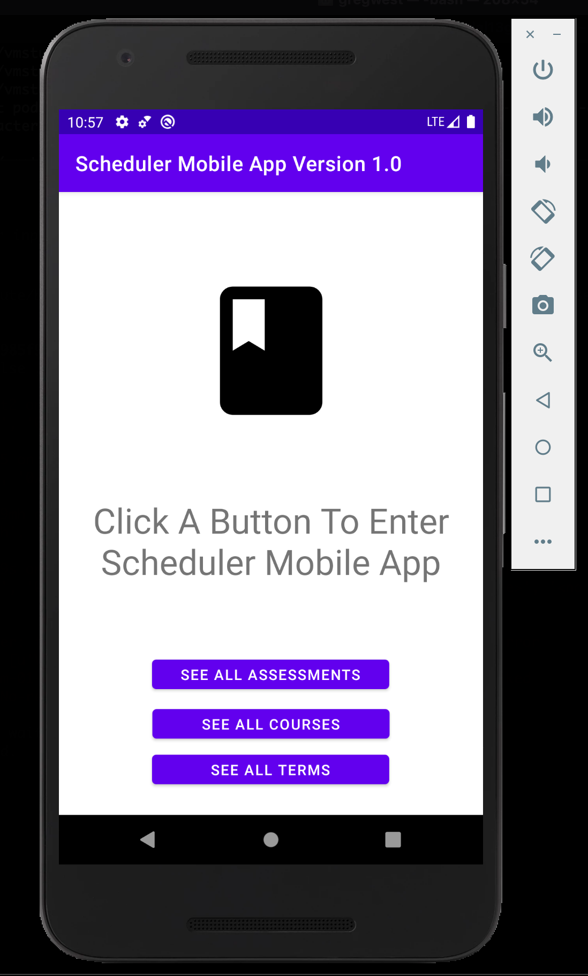
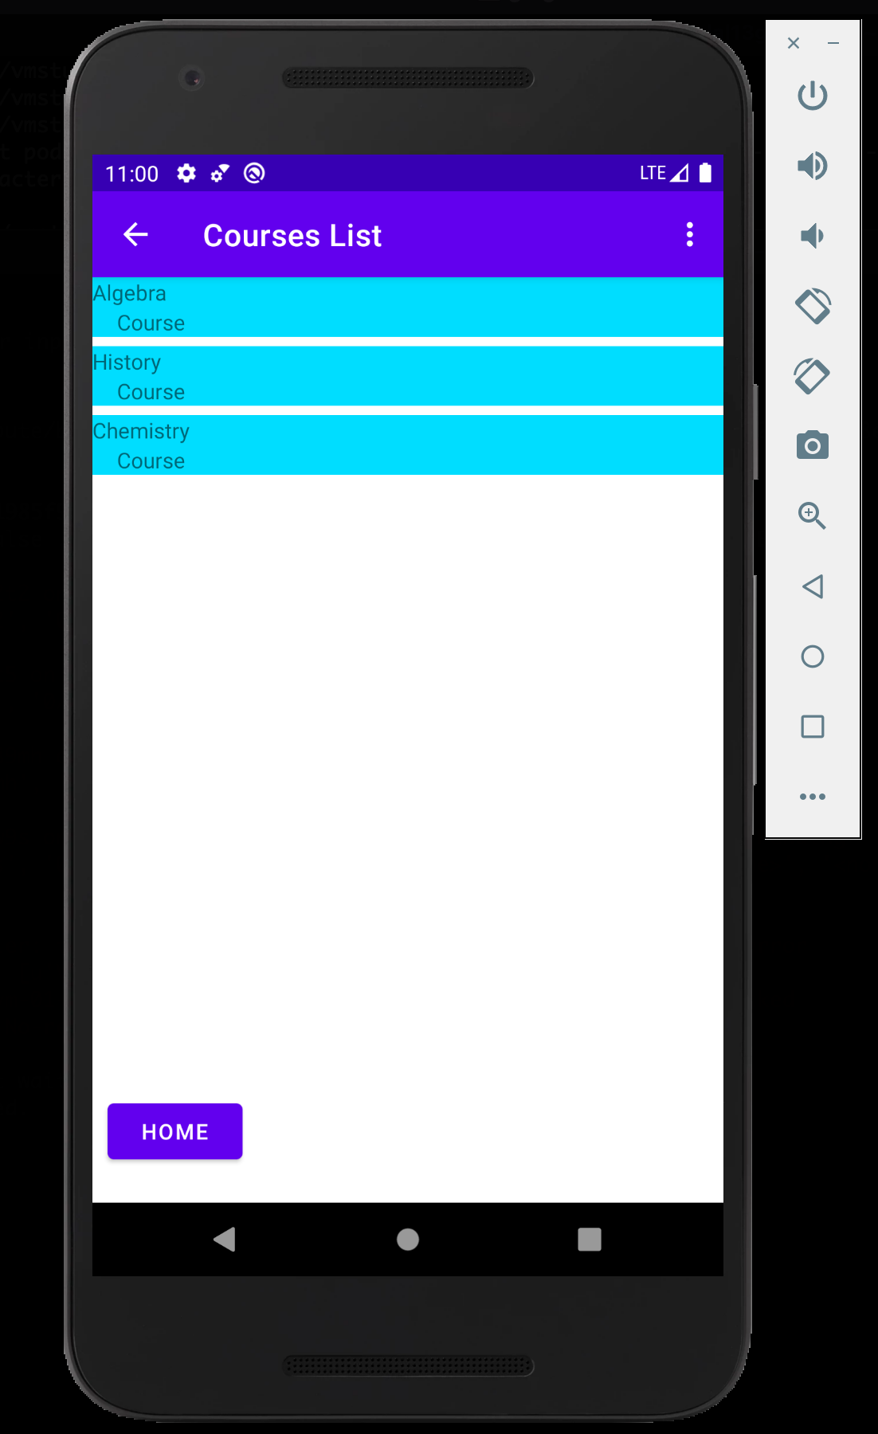
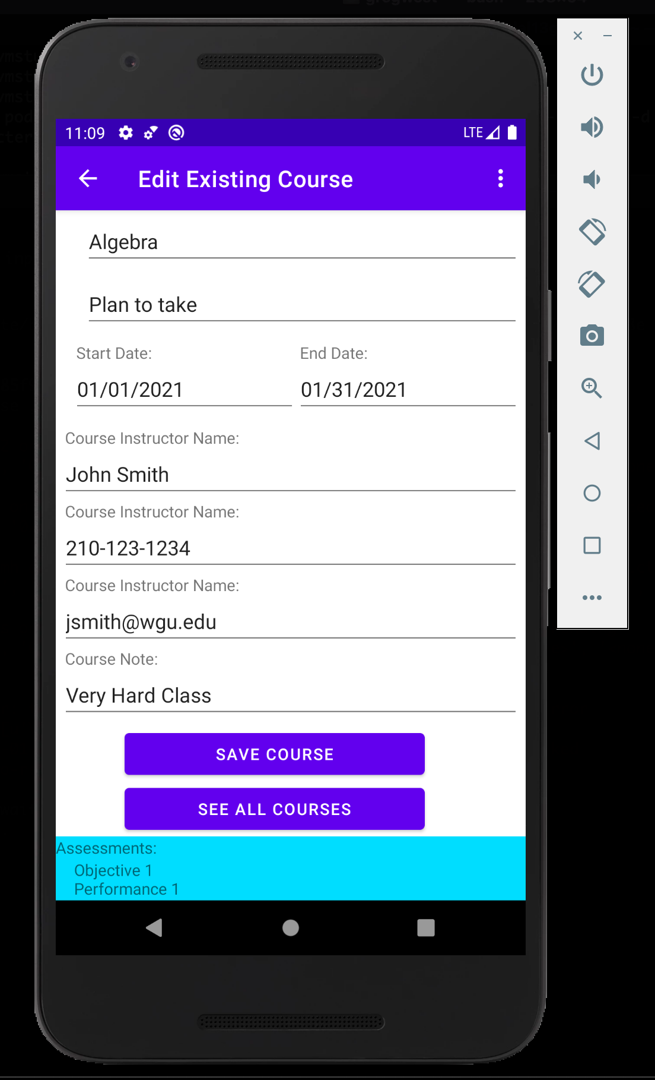
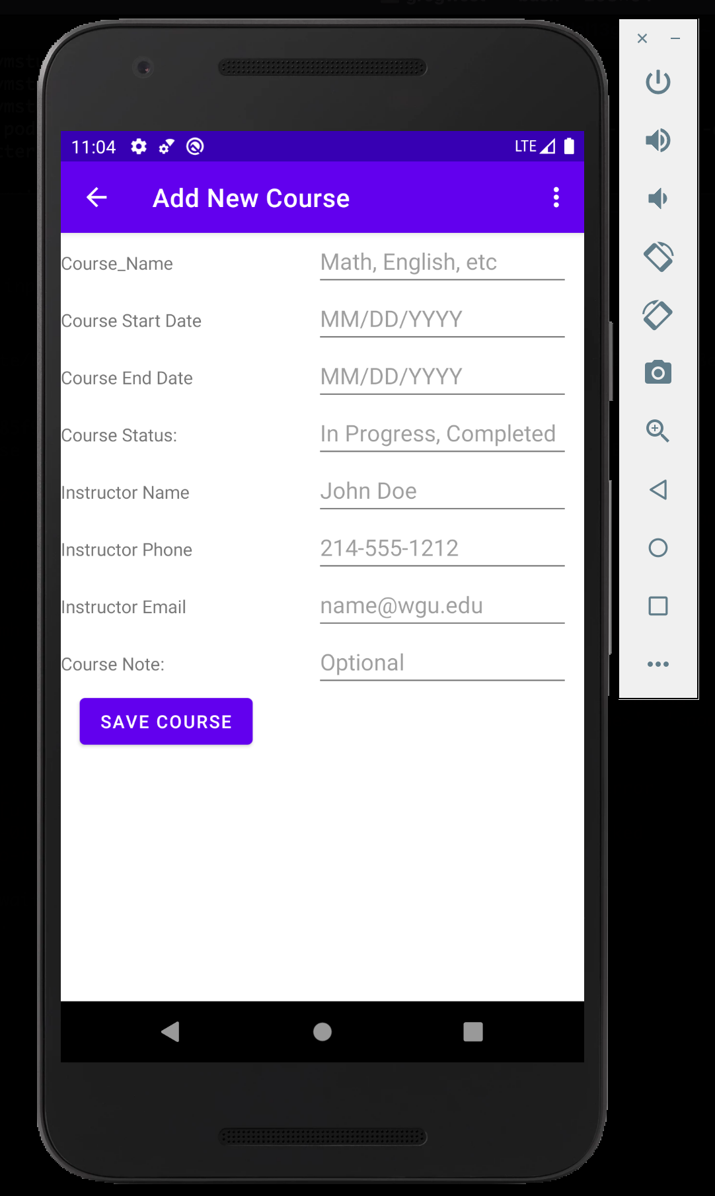
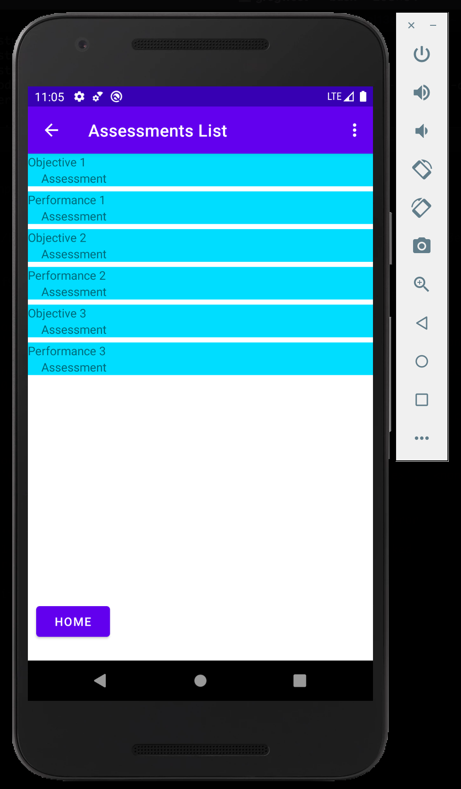
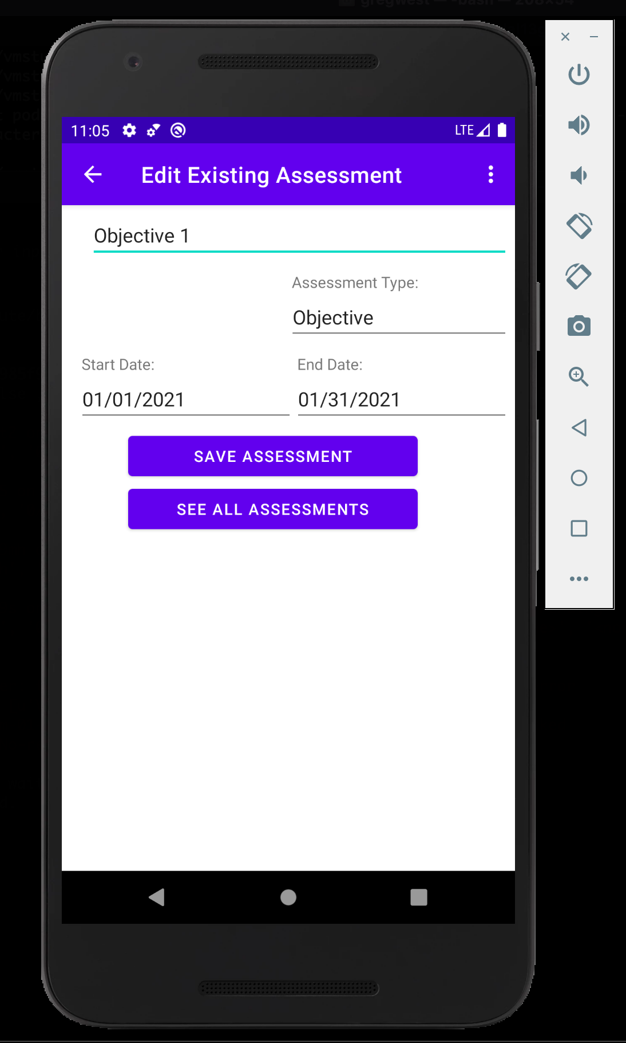
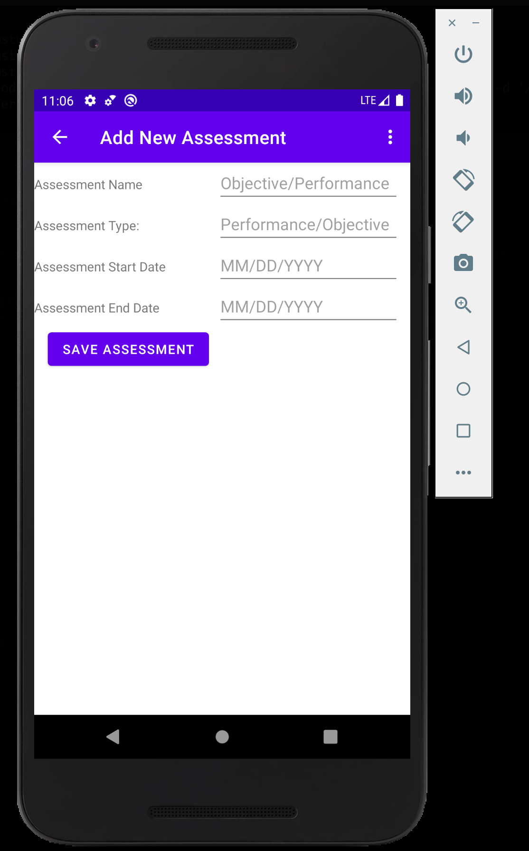








Slide 3
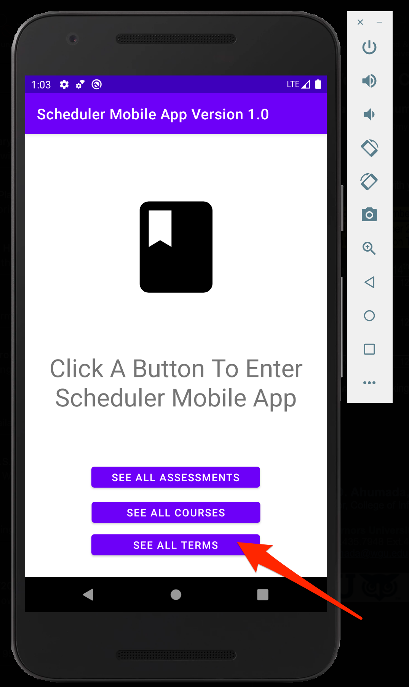
Main Screen
See All Terms

Slide 4
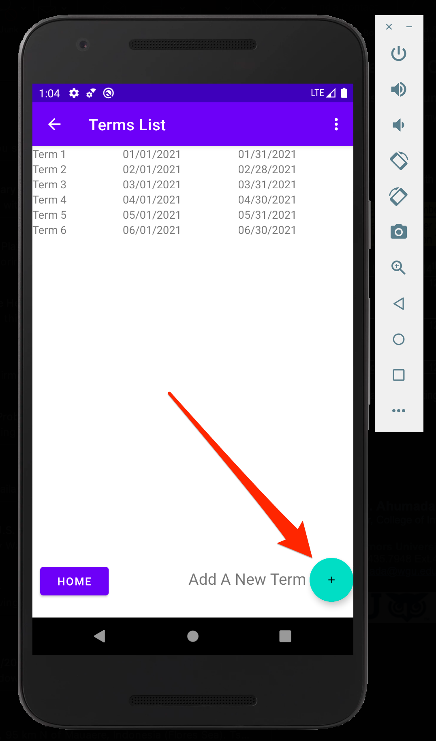
Terms List Page
Add New Term

Slide 5
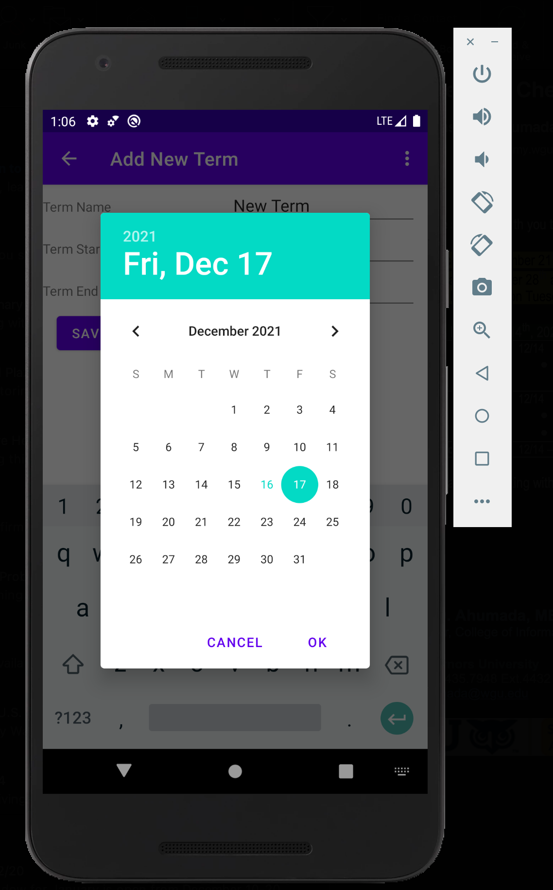
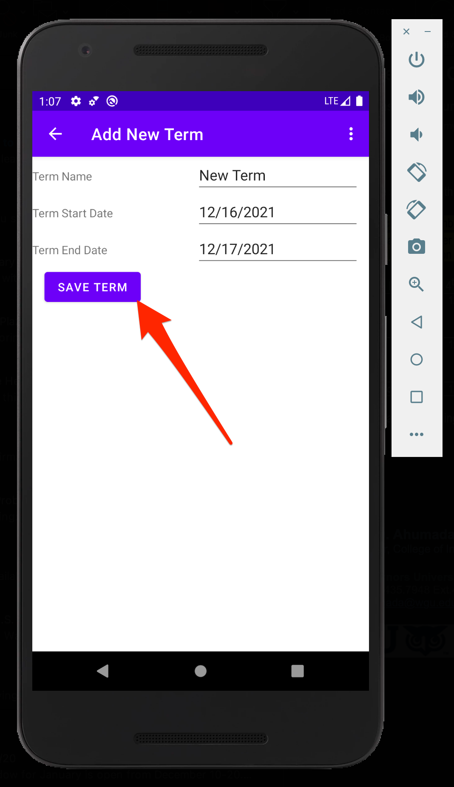
Add New Term
Fill In Data
Click Save

Slide 6
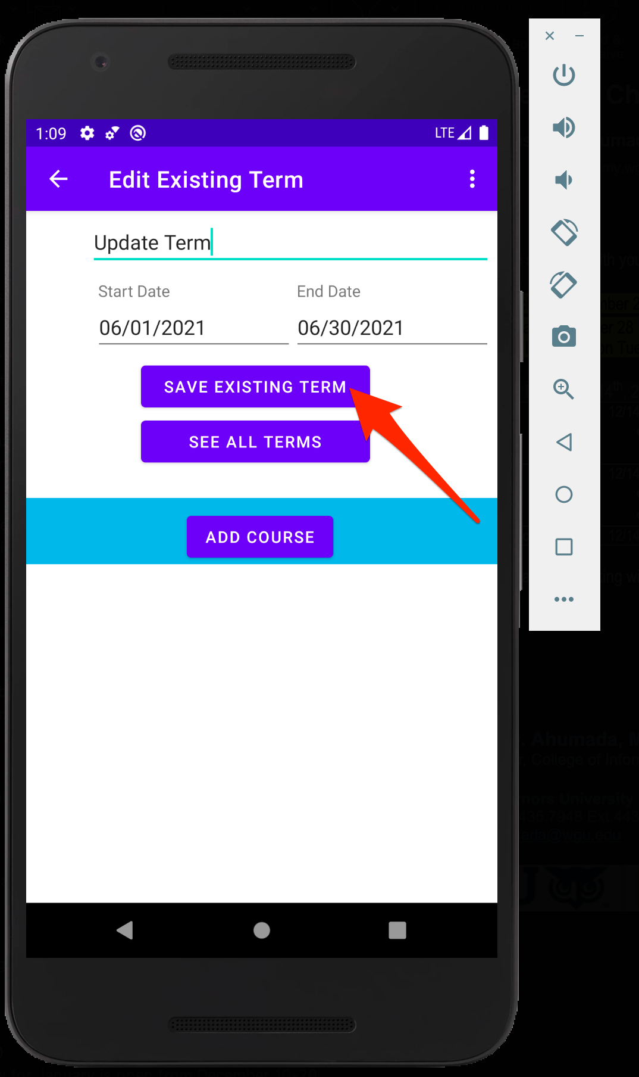
Edit Existing Term
Update Data
Save Existing Term

Slide 7
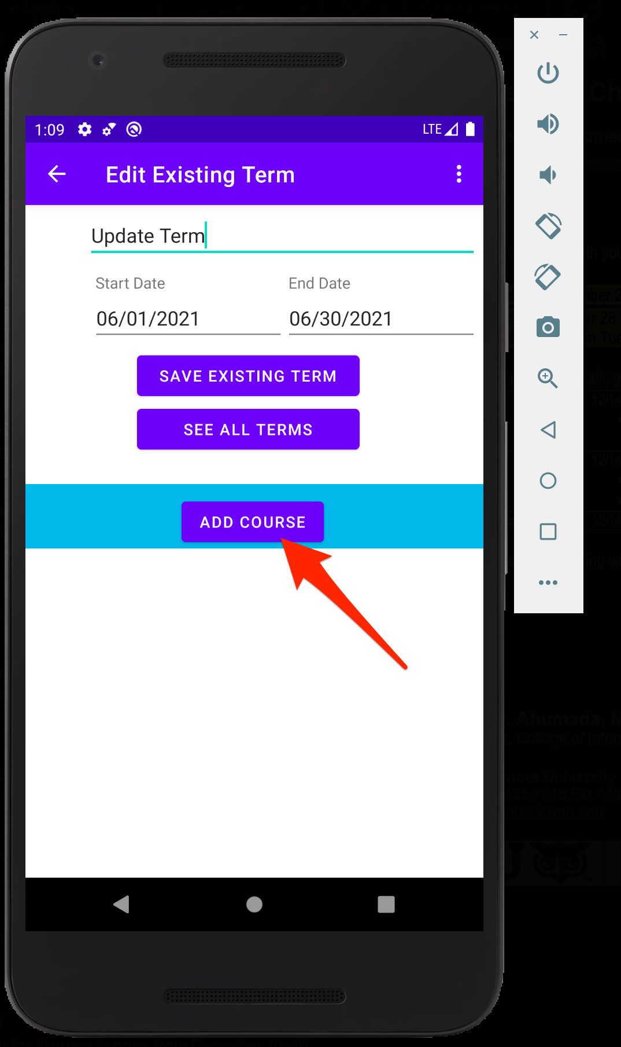
Add New Course – Part 1
Add Course

Slide 8
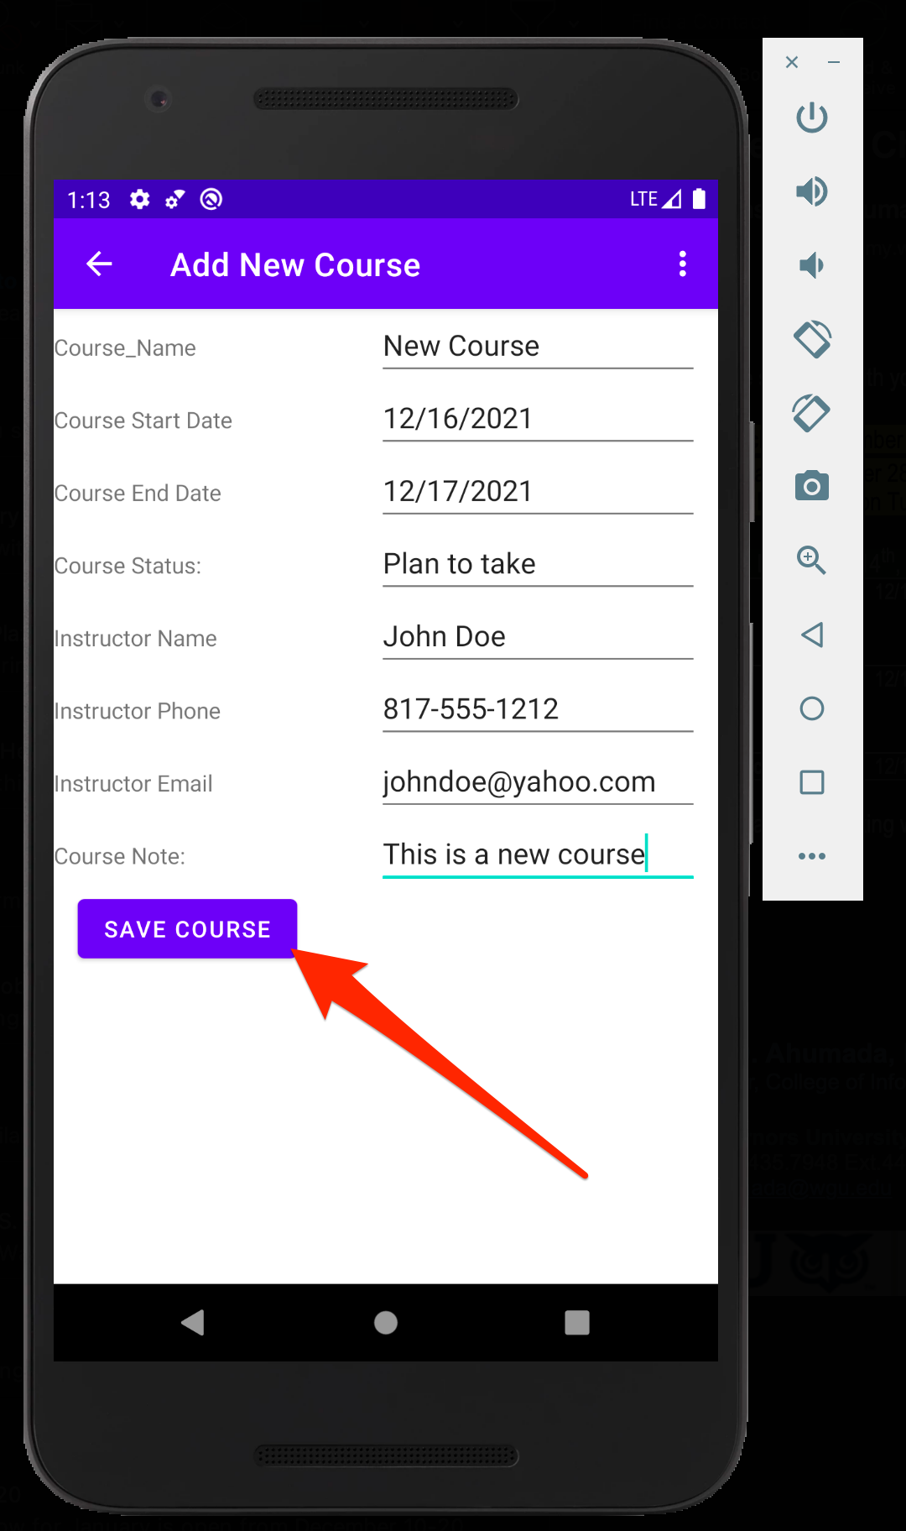
Add New Course – Part 2
Fill in data
Save course

Slide 9
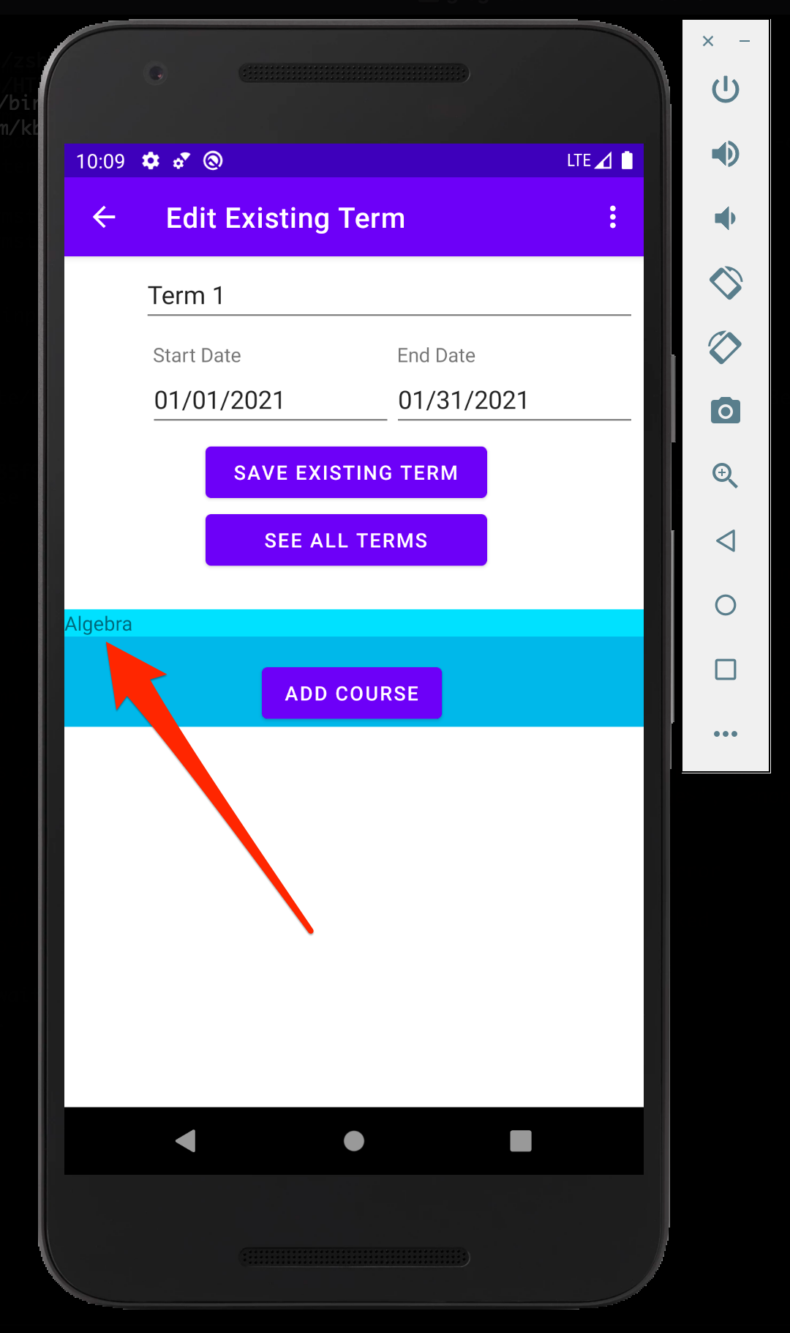
Edit Existing Course – Part 1
Click Course To Edit

Slide 10
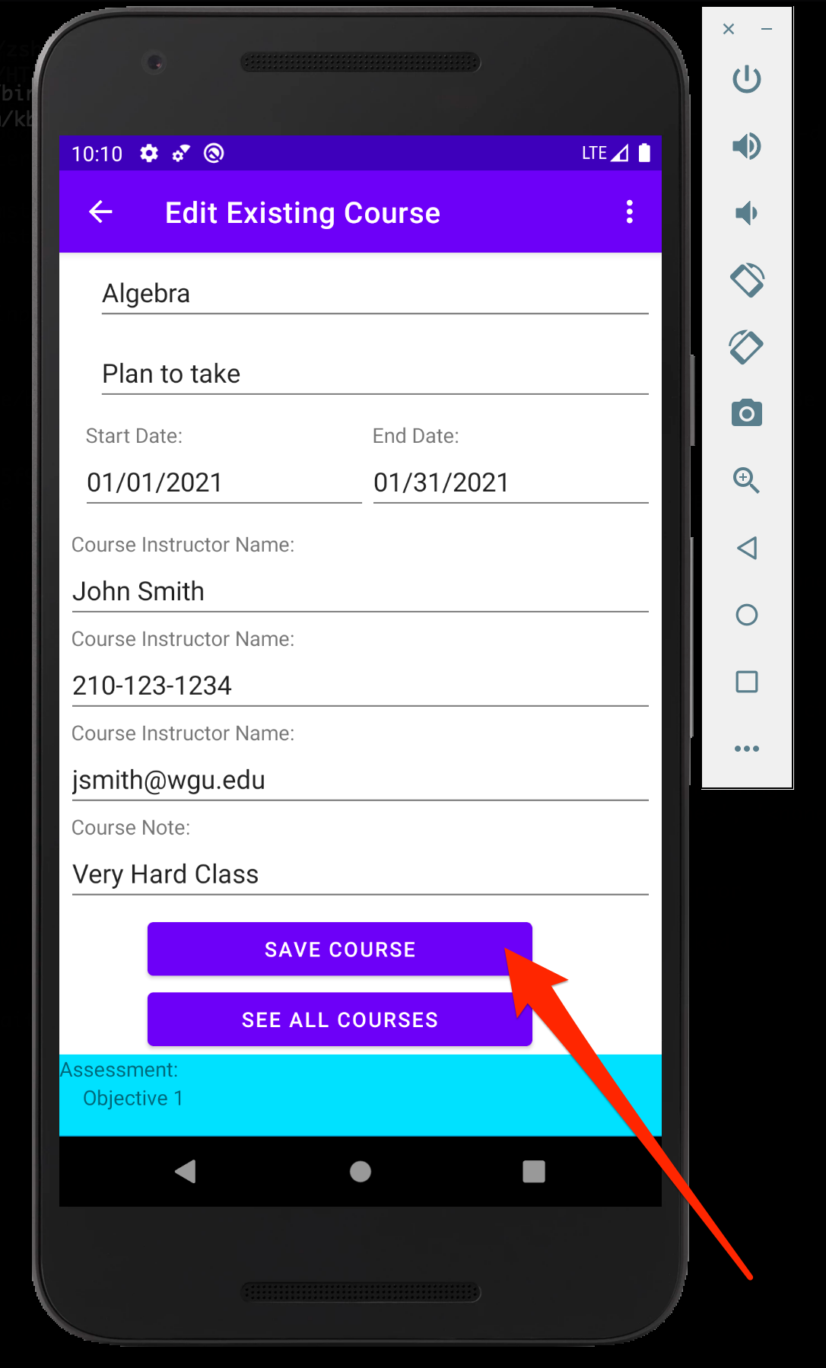
Edit Existing Course – Part 2
Make Changes
Save Course

Slide 11
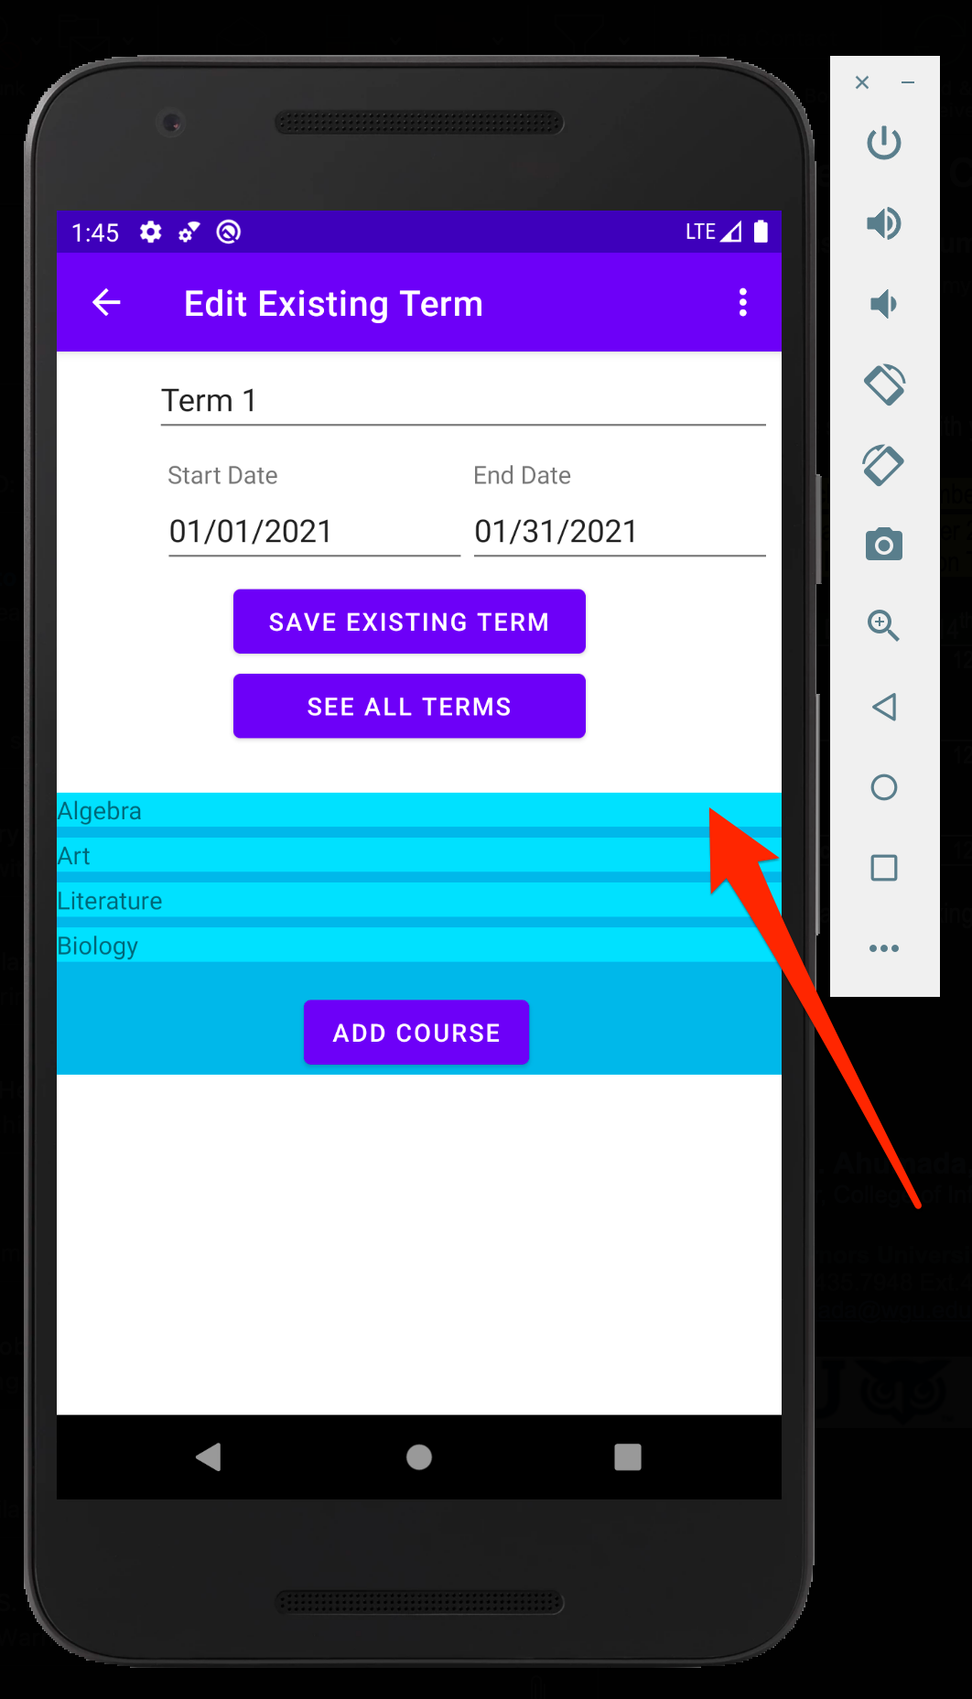
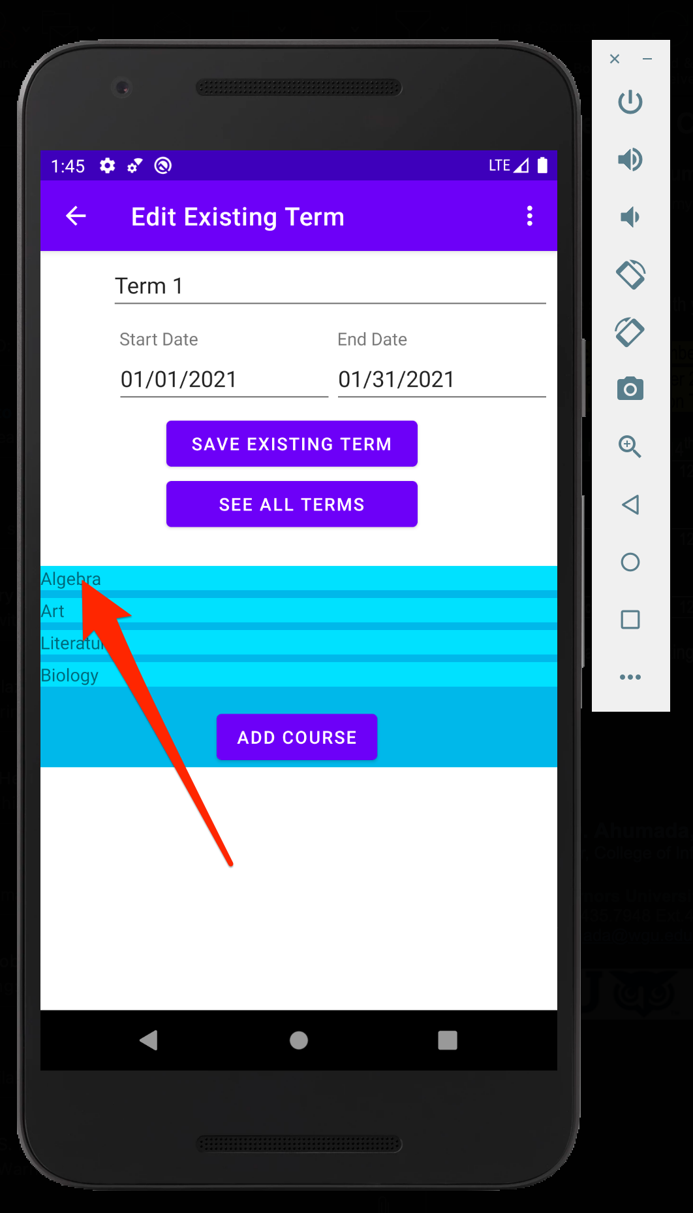

Delete Course From Term
Click and drag course from right to left on screen with mouse swipe

Slide 12
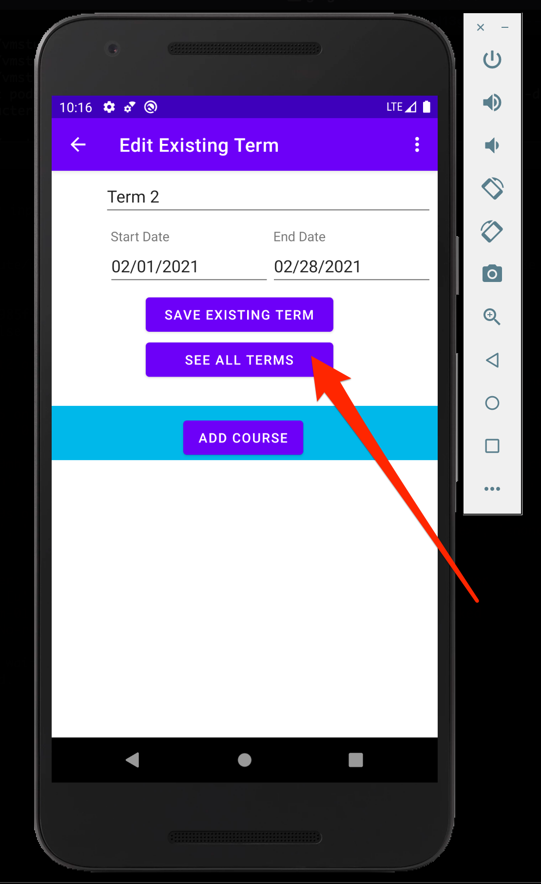
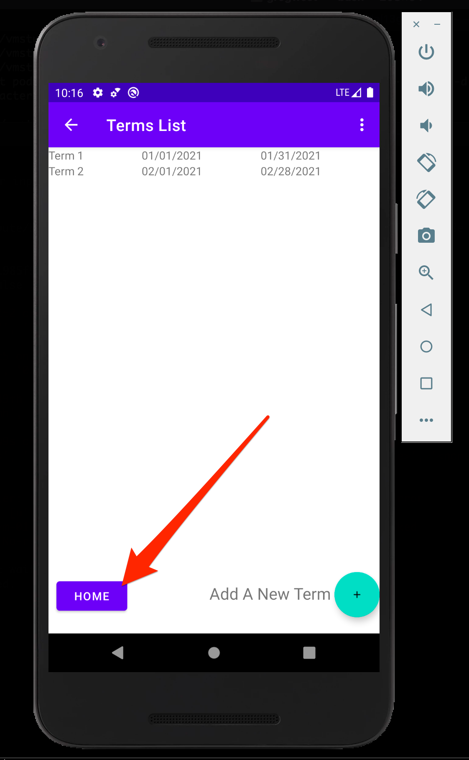
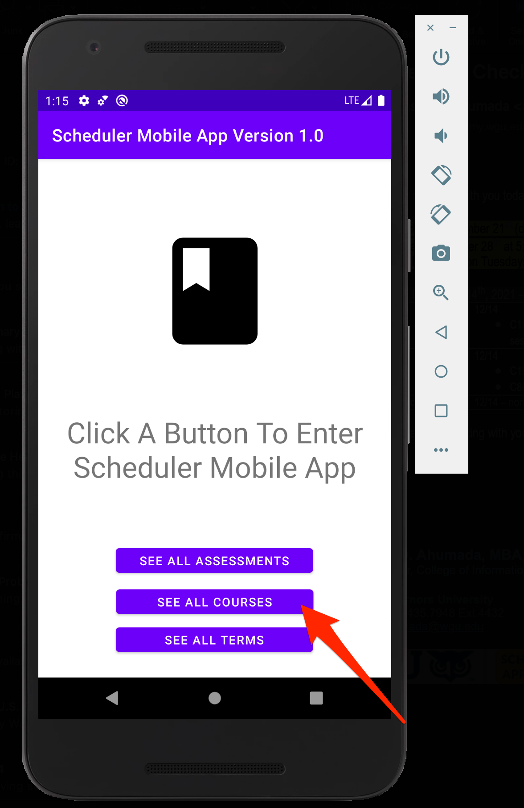
See All Courses
See All Terms
Home
See All Courses

Slide 13
Add New Assessment – Part 1
Click Course

Slide 14
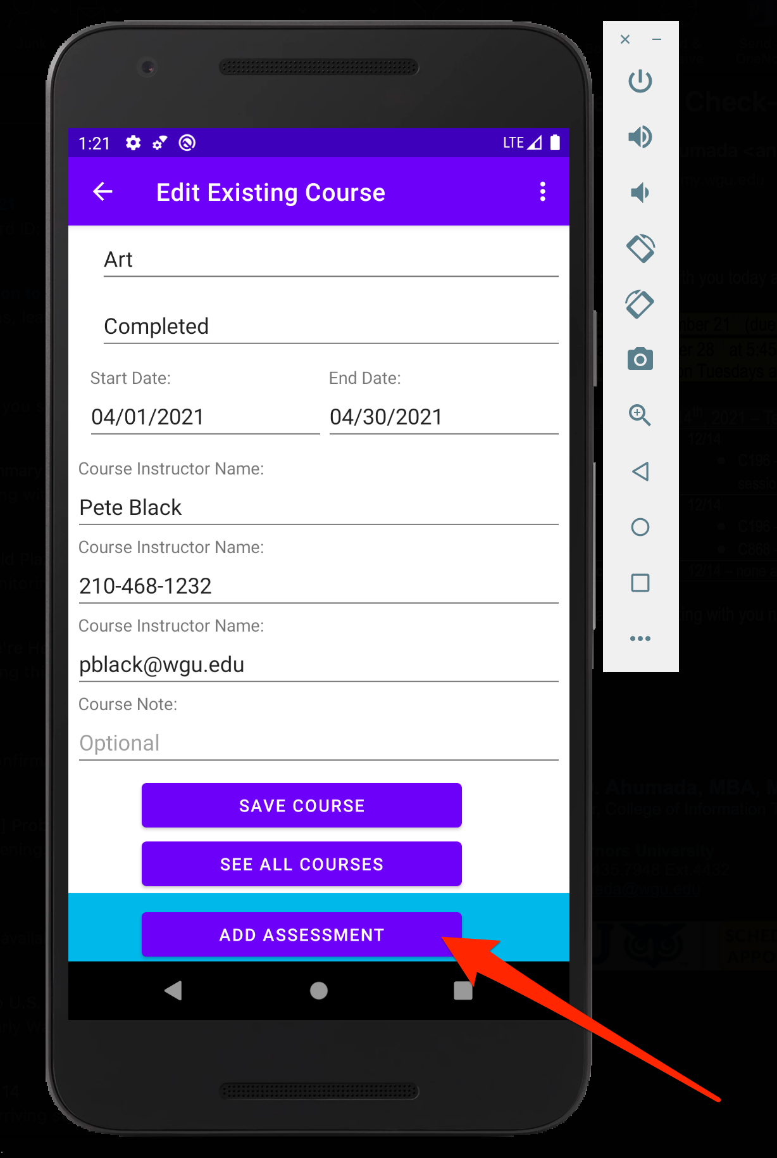
Add New Assessment – Part 2
Add Assessment

Slide 15
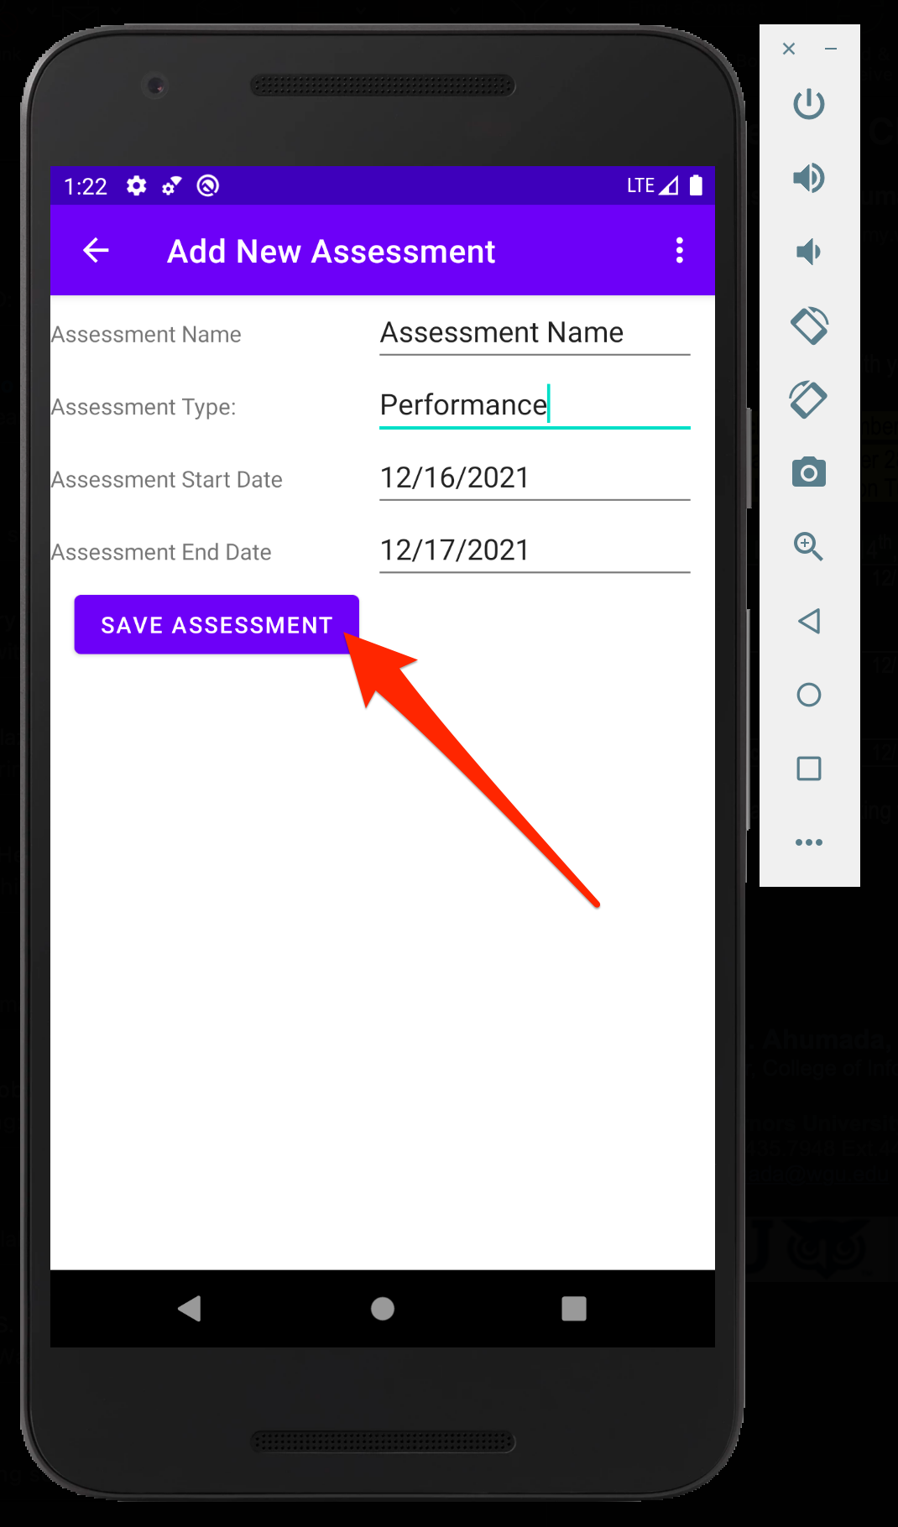
Add New Assessment – Part 3
Save Assessment

Slide 16
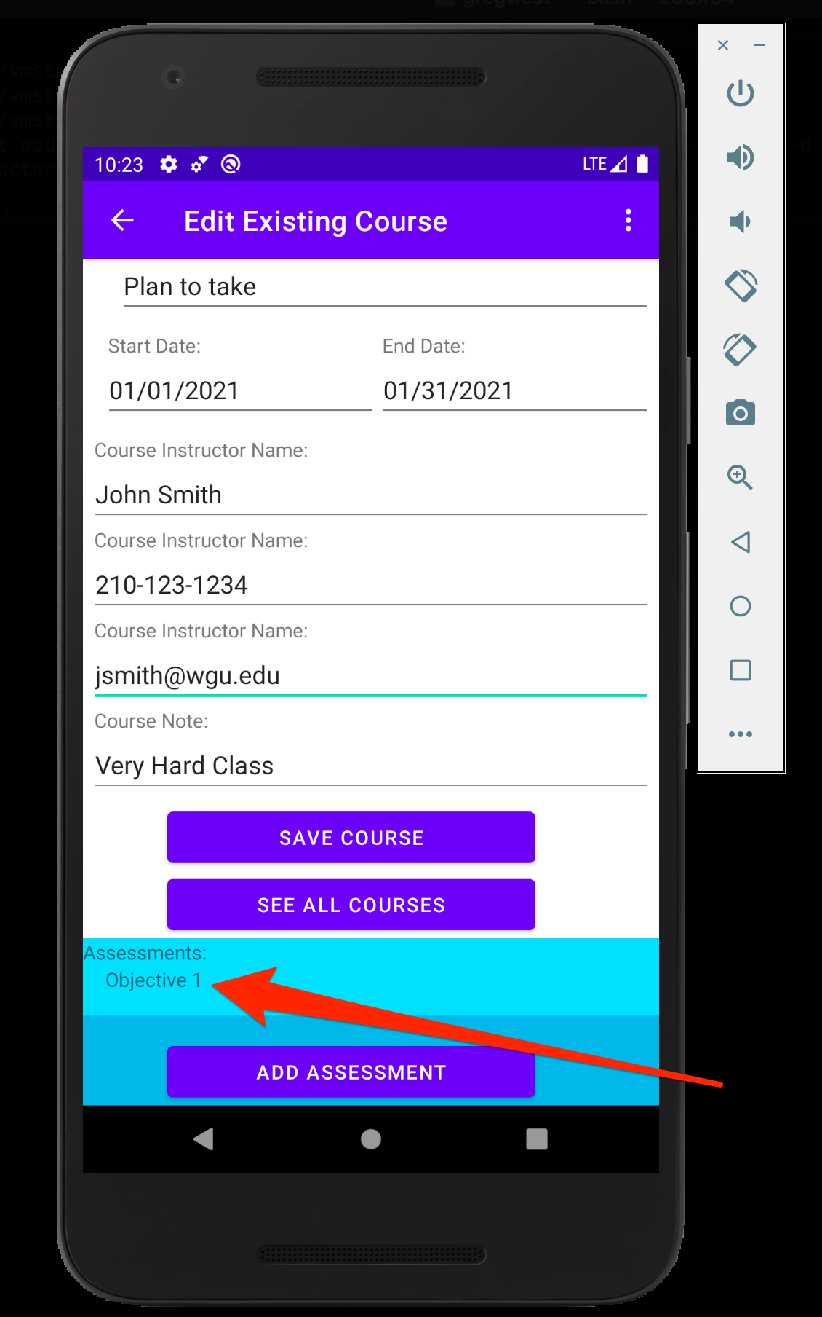
Edit Existing Assessment – Part 1
Select Assessment to Edit

Slide 17
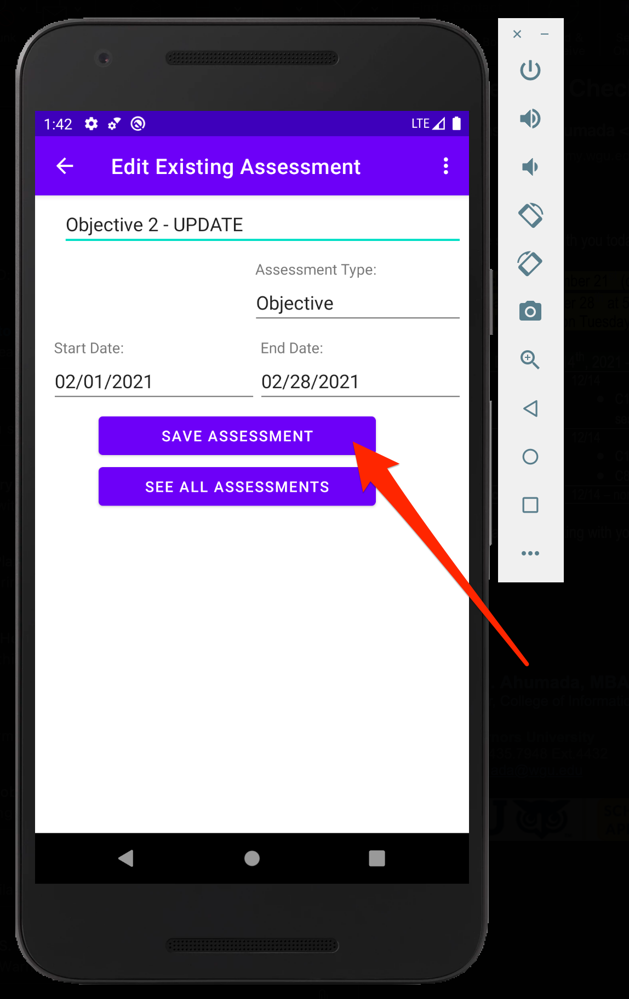
Edit Existing Assessment – Part 2
Update Data
Save Assessment

Slide 18
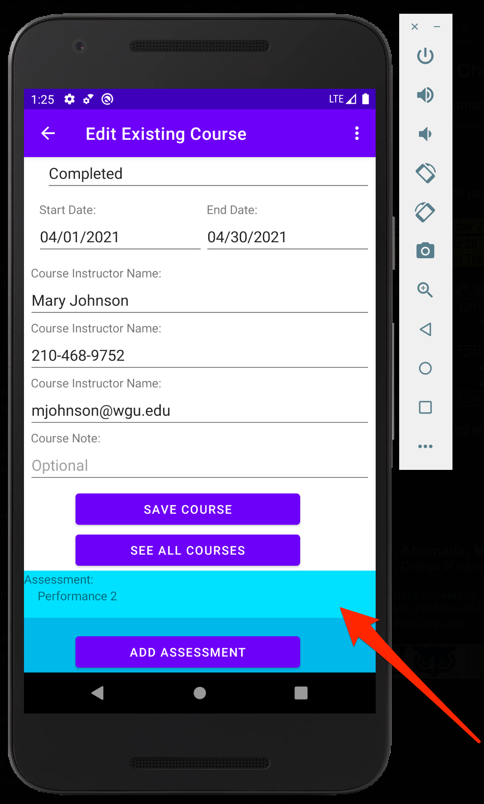
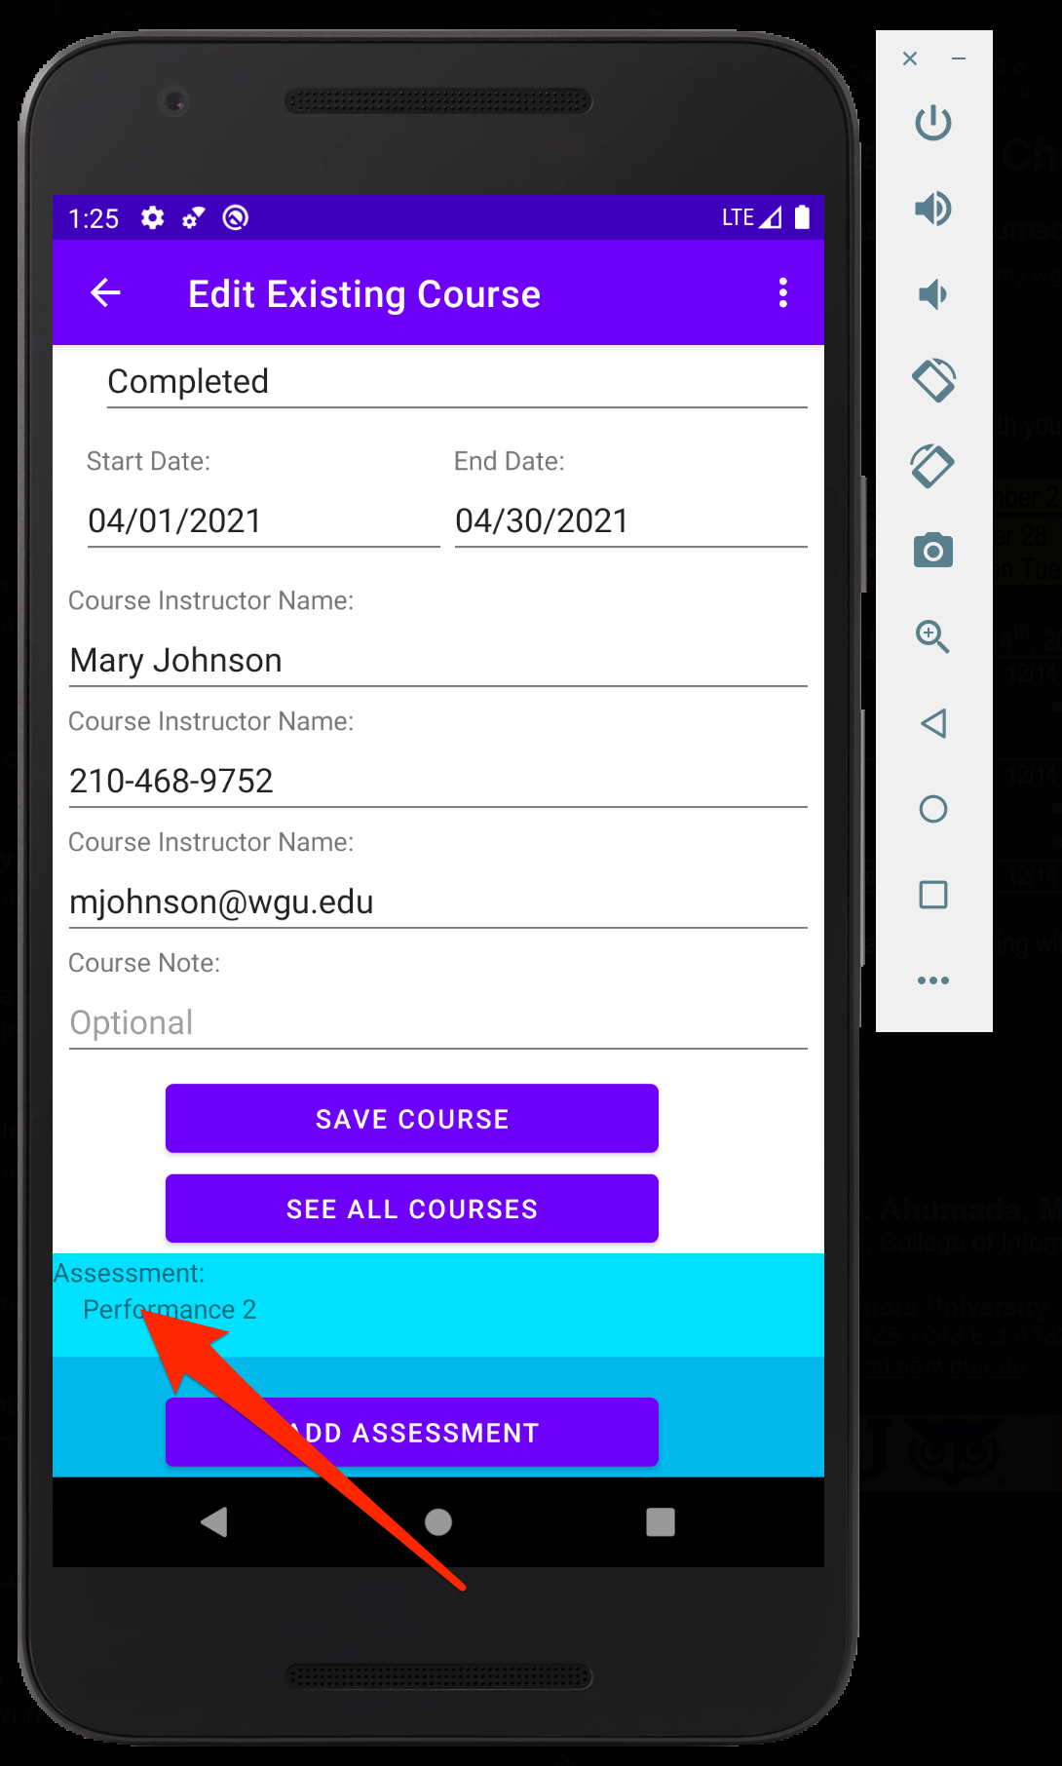
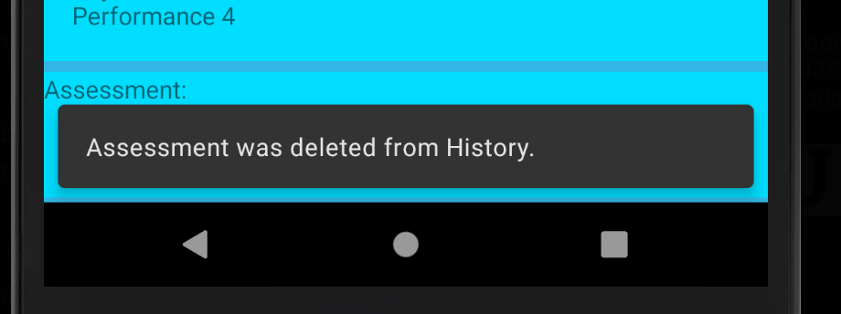
Delete Assessment From Course
Click and drag assessment from right to left on screen with mouse swipe

Slide 19
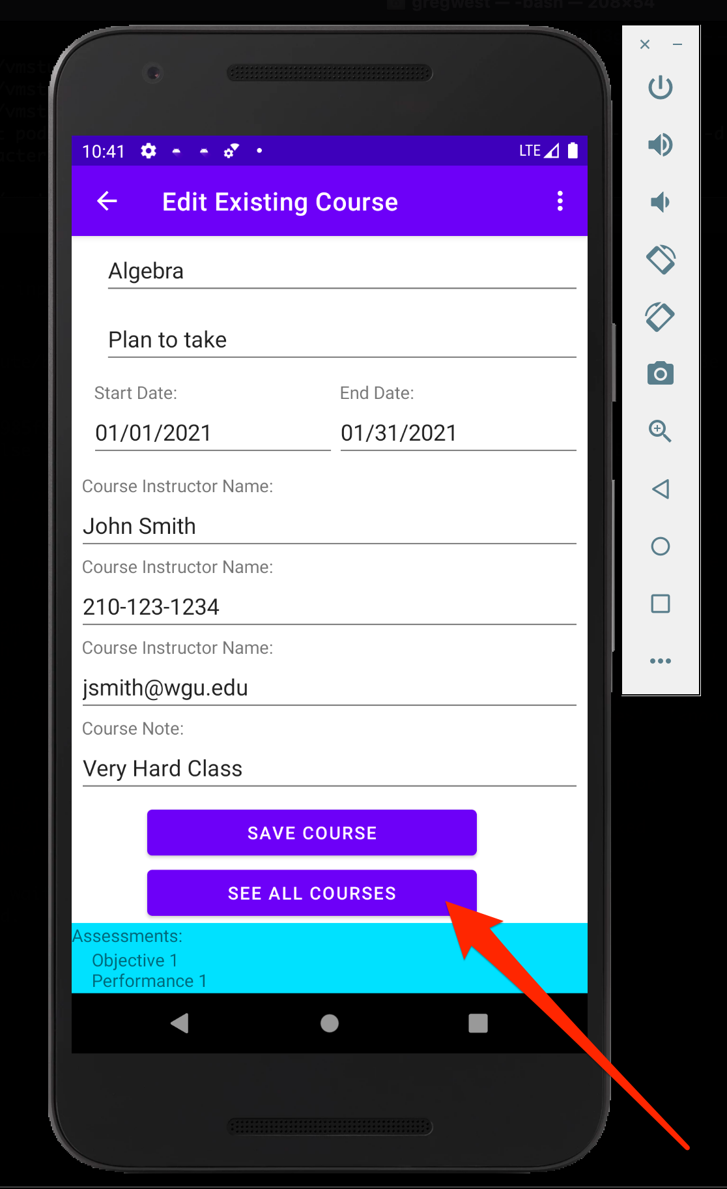
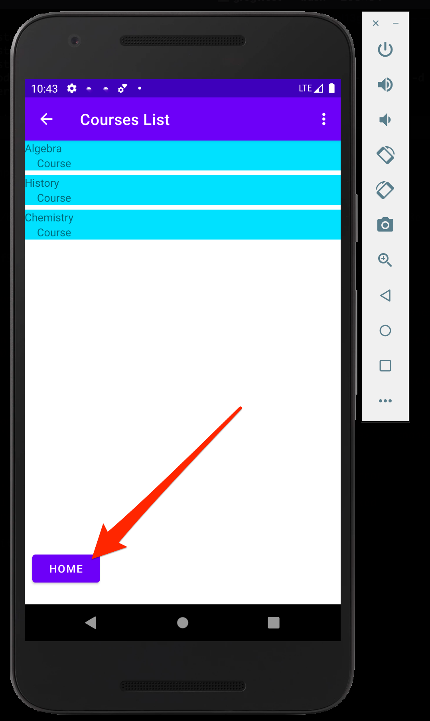
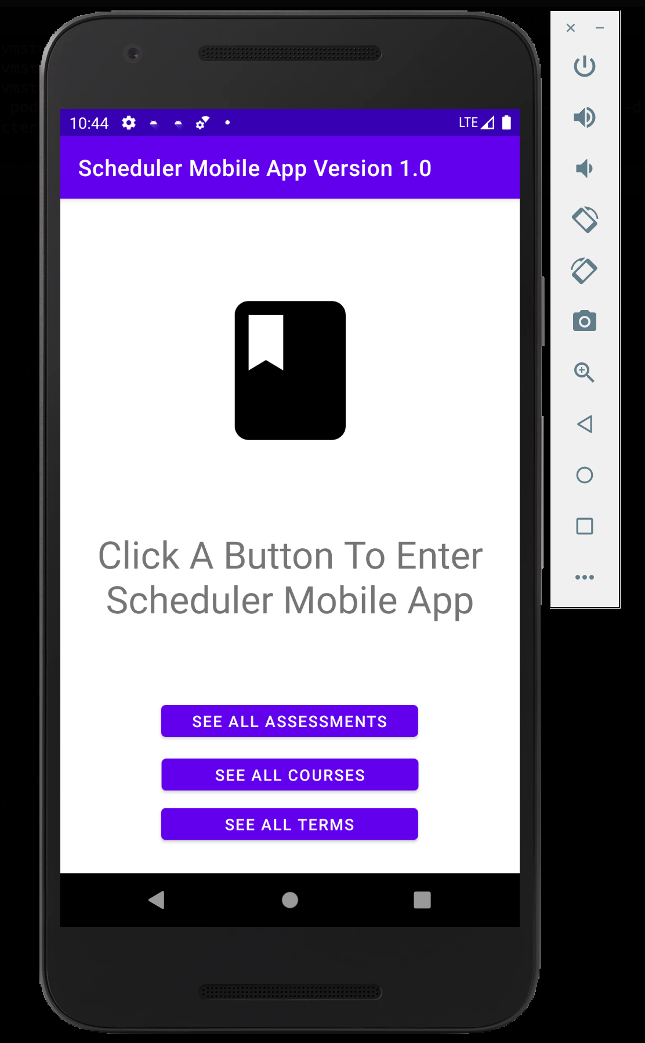
See All Assessments
See All Courses
Home
See All Assessments

Slide 20
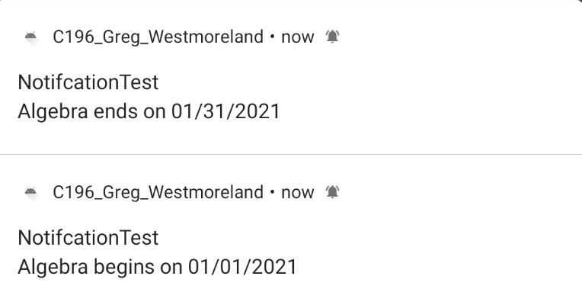
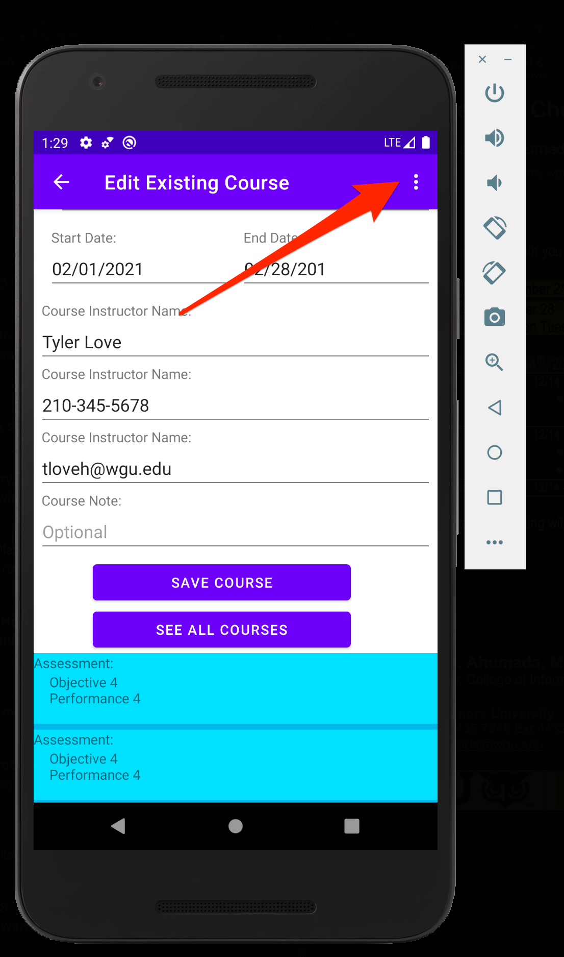
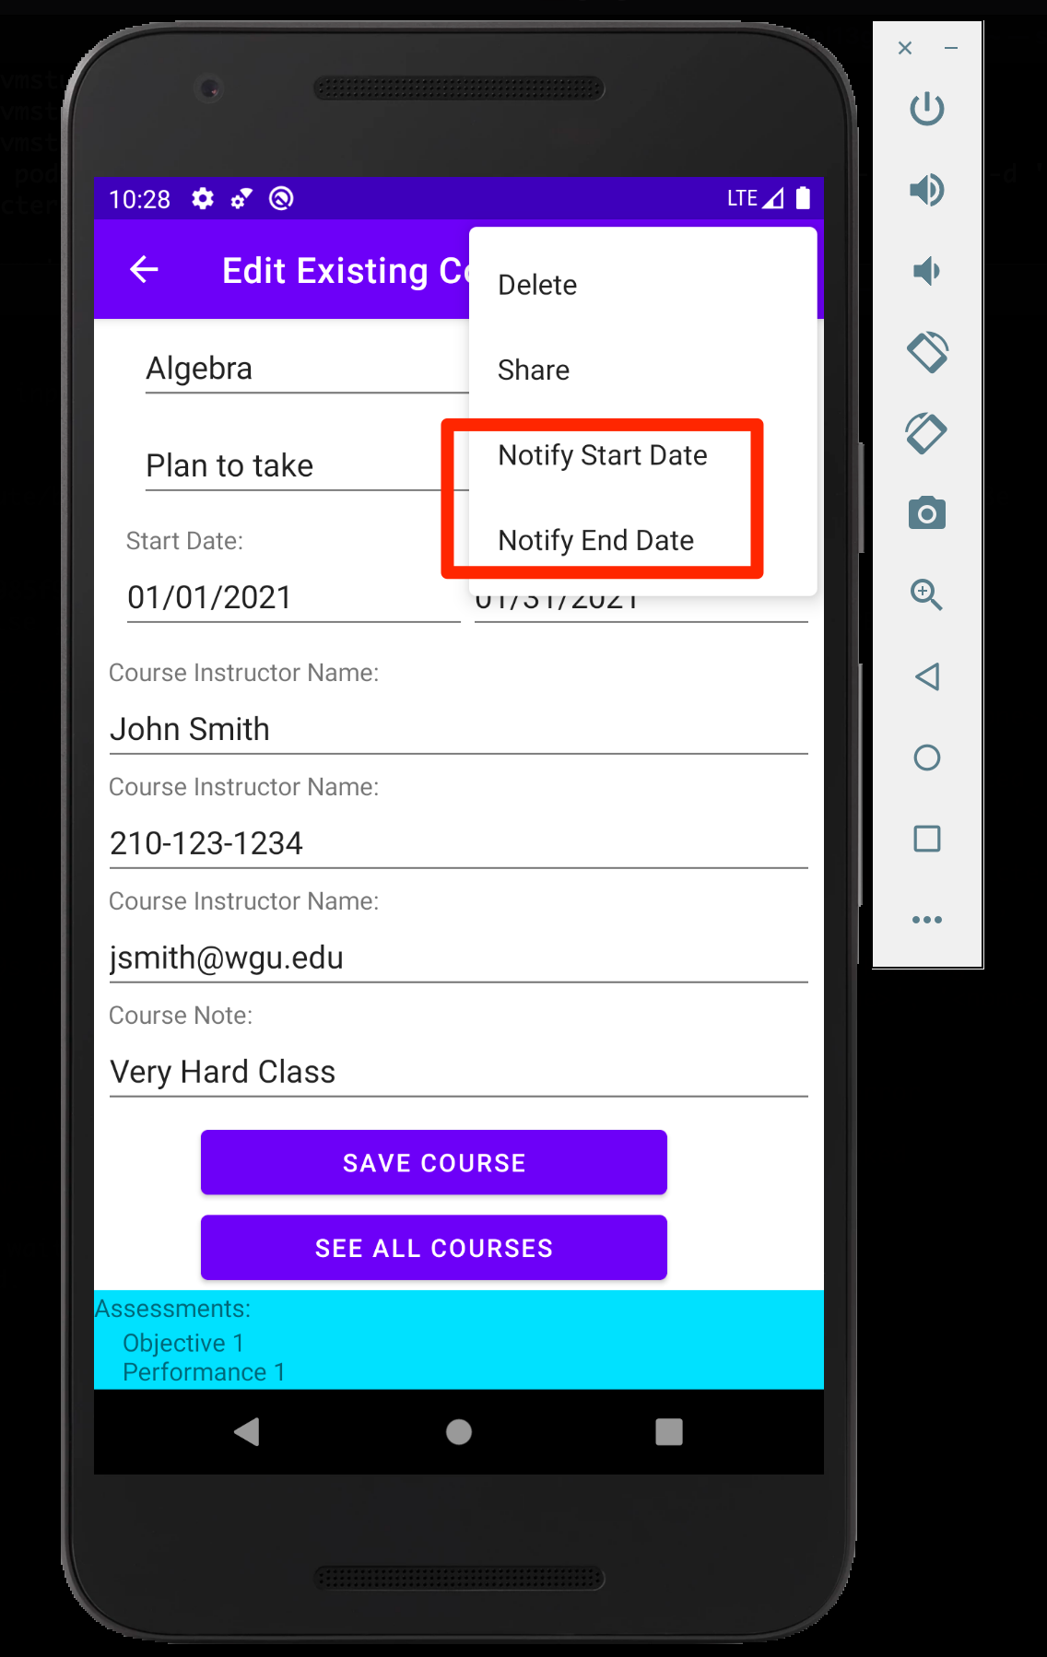
There Are 2 Notify Selections * One For Start Date * One For End Date
Click 3 Vertical Dots
Select Notify Start for Start Date Notification
Select Notify End for End Date Notification
Wait for Notification

Slide 21
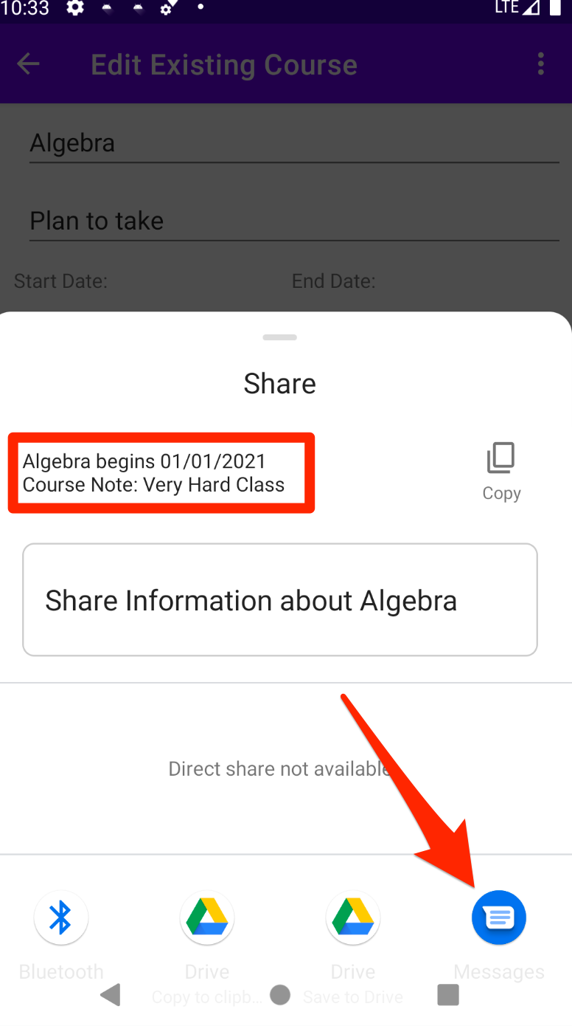
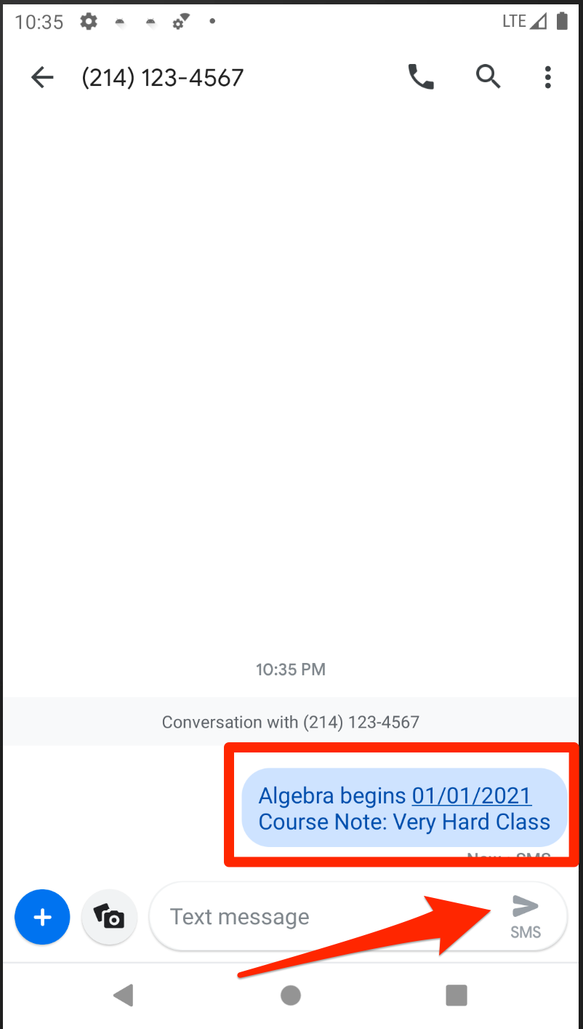
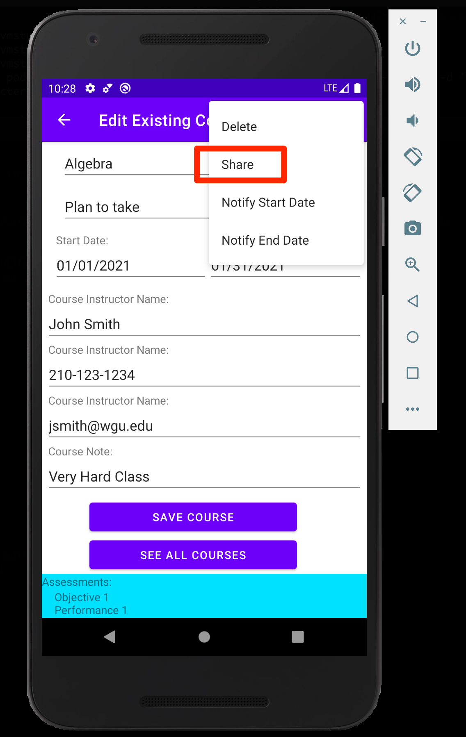
Share Course Note
Click 3 Vertical Dots
Select Share and Select SMS
Wait for Notification
Send SMS Message

Slide 22
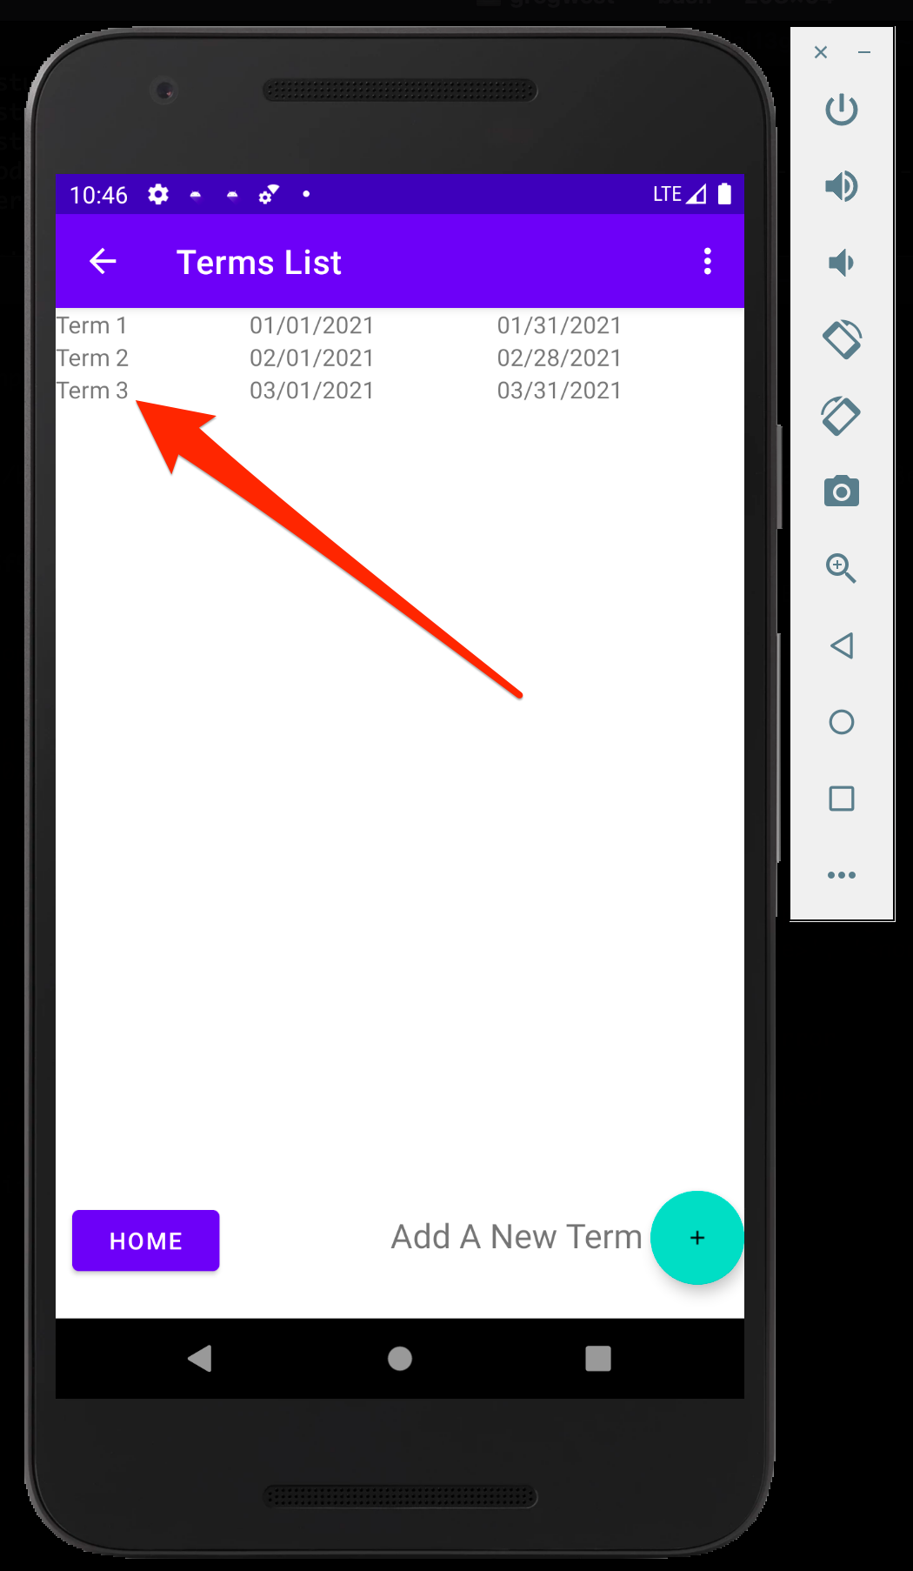
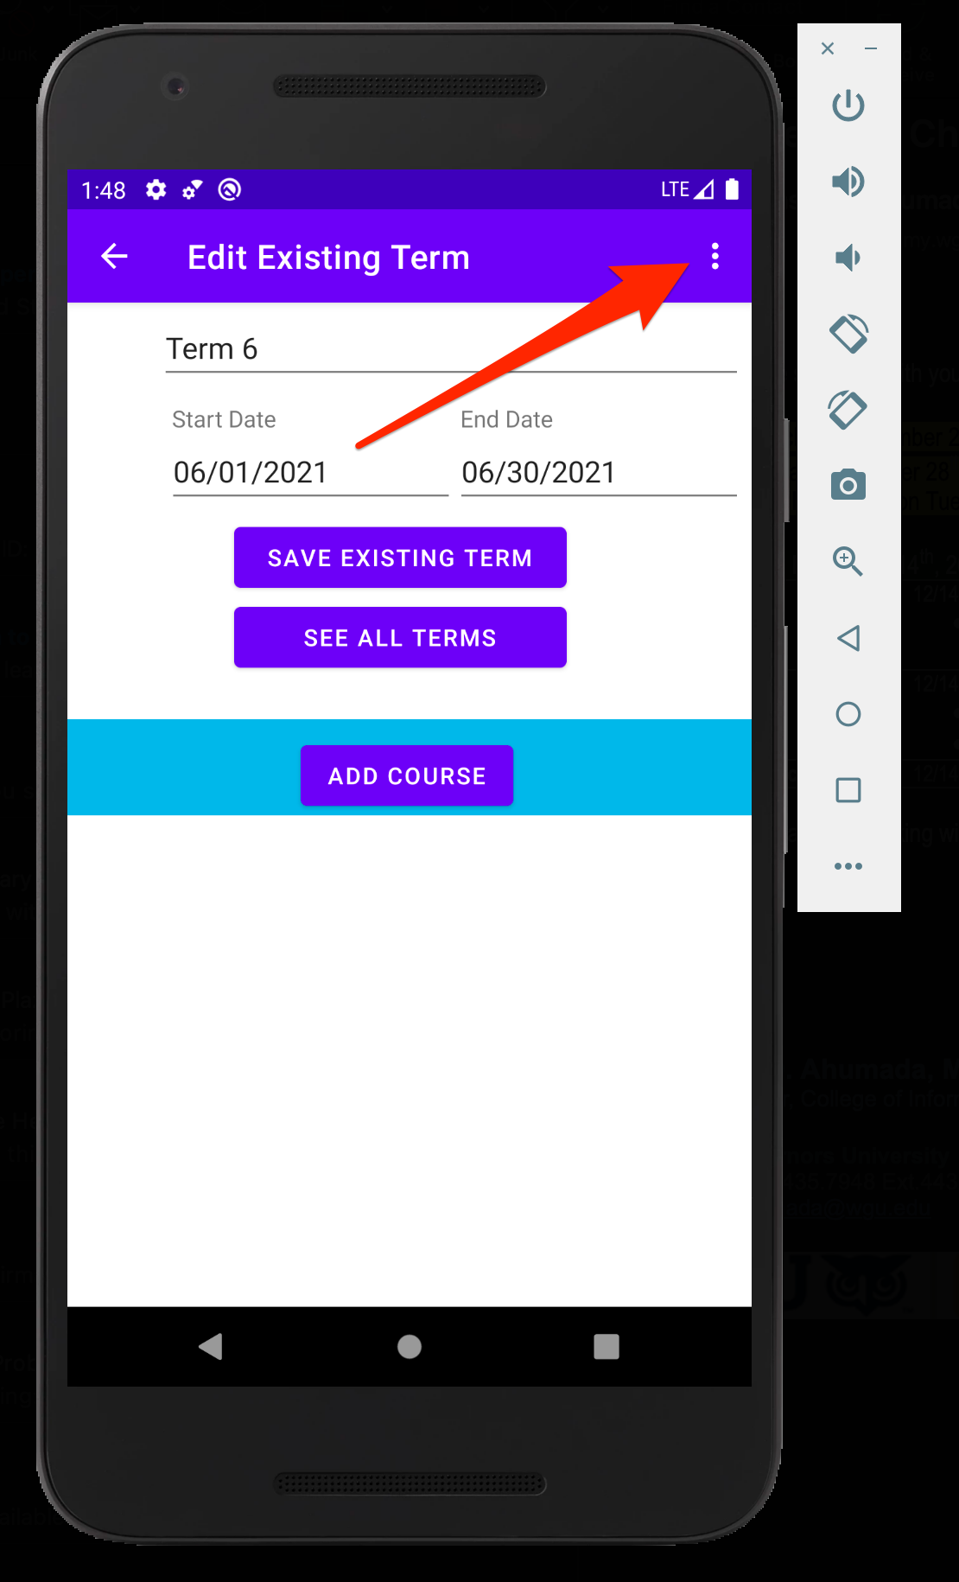
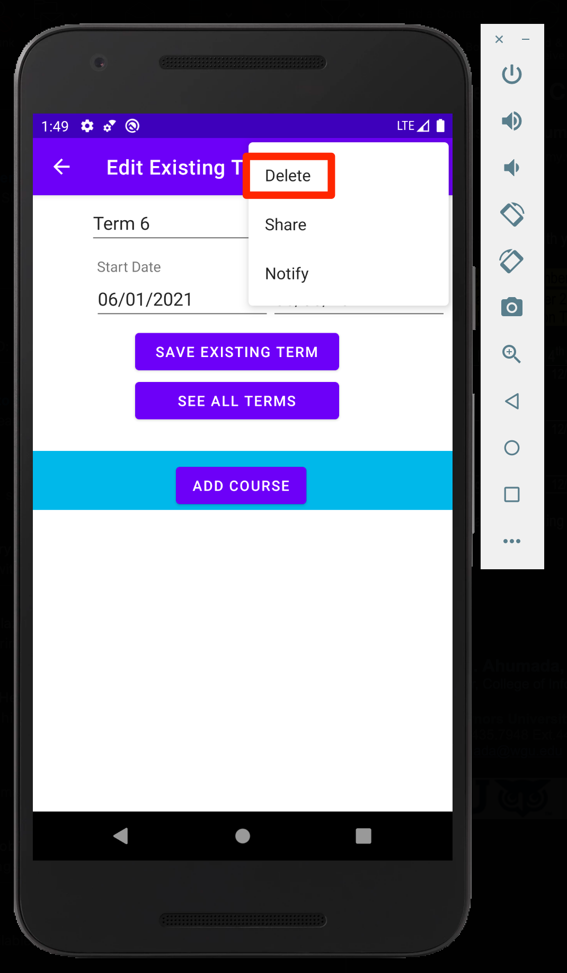
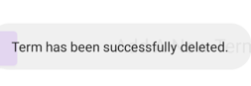
Delete Term
Select Existing Term
Select 3 Vertical Dots
Select Delete
Confirmation Message

Slide 23
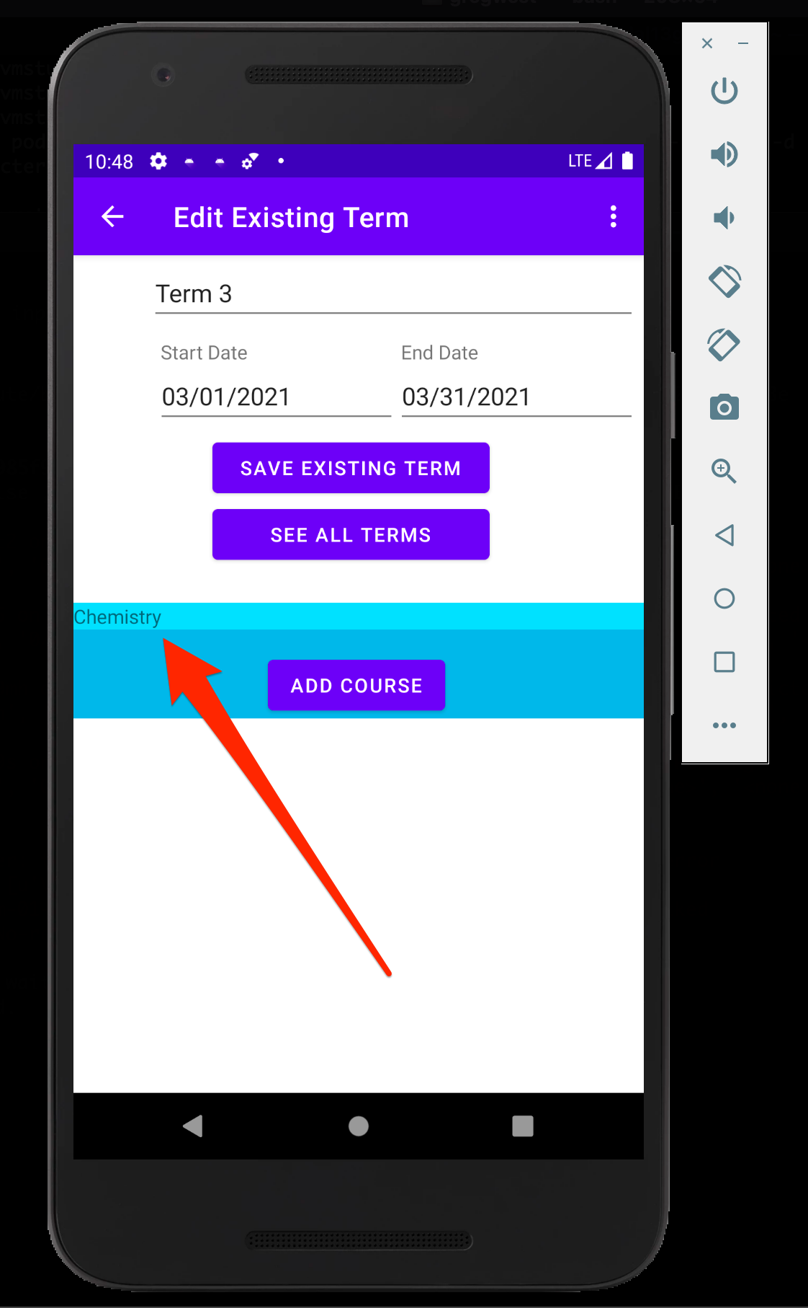
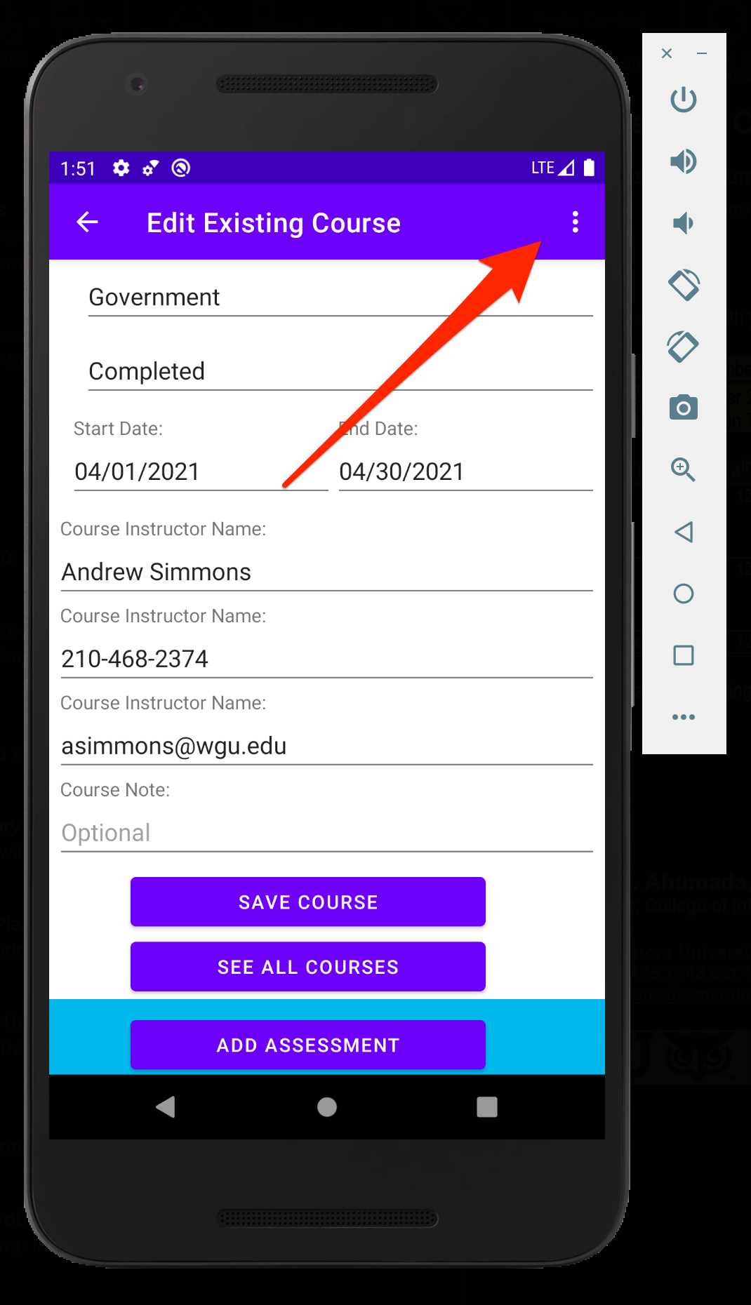
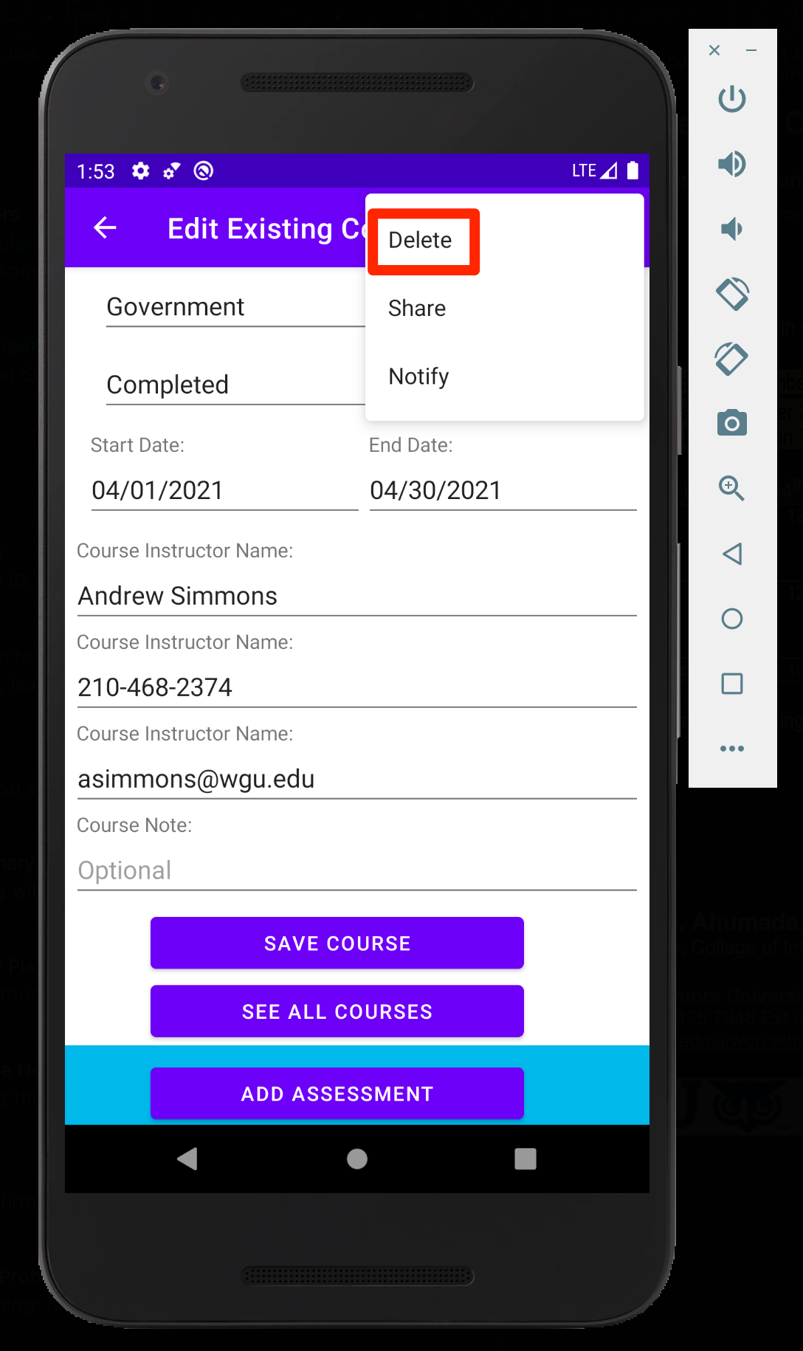
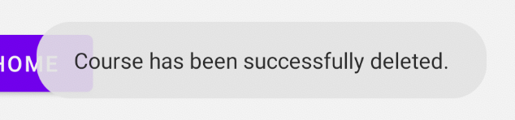
Delete Course
Select Existing Course
Select 3 Vertical Dots
Select Delete
Confirmation Message

Slide 24
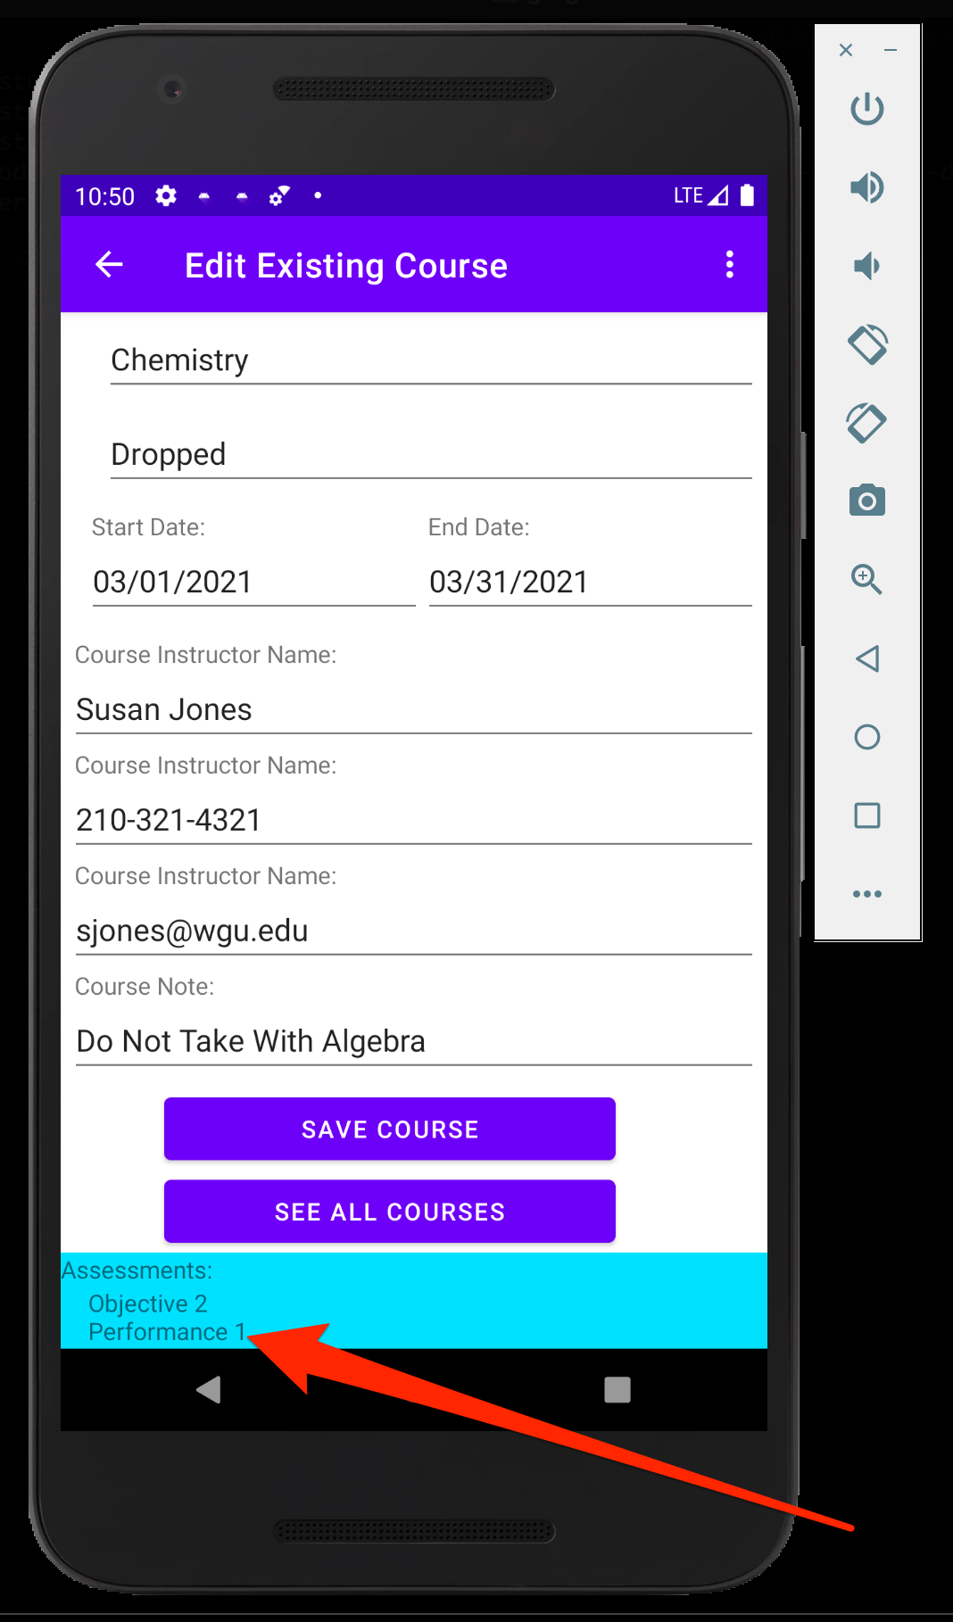
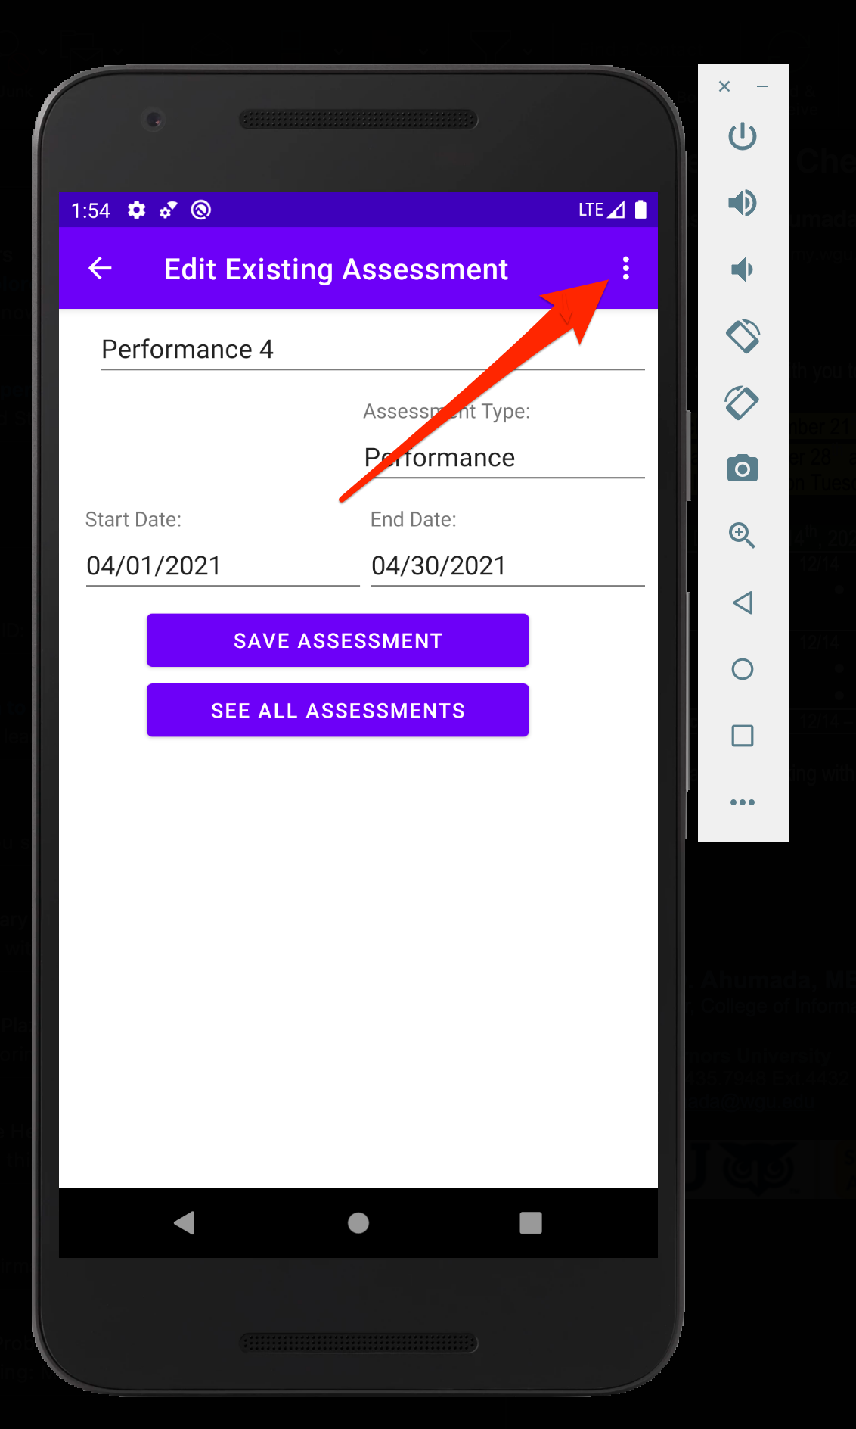


Delete Assessment
Select Existing Assessment
Select 3 Vertical Dots
Select Delete
Confirmation Message

Slide 25
The End

